Slide 1
Using Globus CLI for Automated Transfers
Thomas Marullo 01/10/2019

Slide 2
Prerequisites
DesignSafe-CI account
Globus account
Linux or *nix environment with Python 2.7
“cron” or other task scheduling program

Slide 3
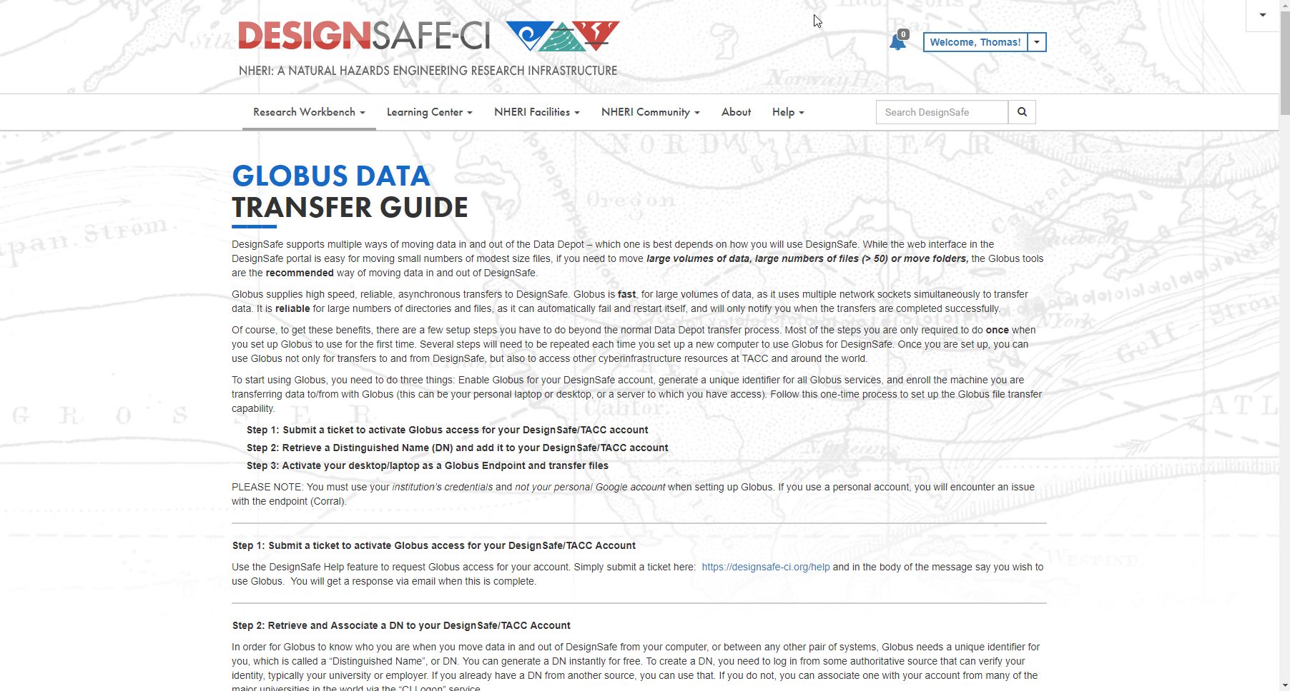
Globus Data Transfer Guide
https://www.designsafe-ci.org/rw/user-guides/globus-data-transfer-guide/

Slide 4
Steps to Automate Globus Transfer
Find Endpoint IDs

Slide 5
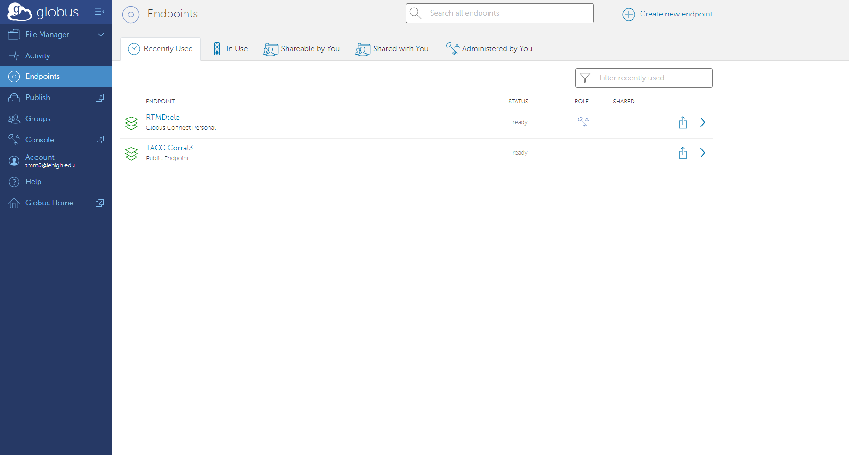
Globus Endpoints

Slide 6
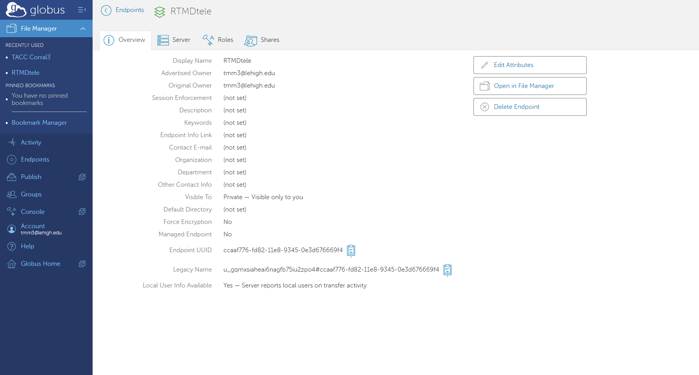
Globus Endpoints

Slide 7
Globus Endpoints

Slide 8
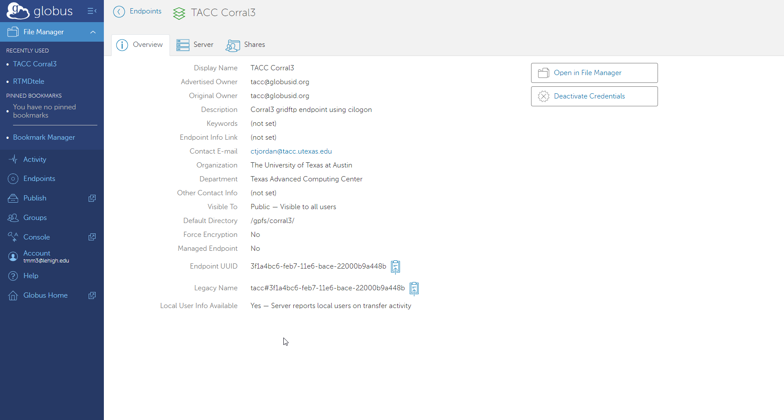
Globus Endpoints

Slide 9
Steps to Automate Globus Transfer
Find Endpoint IDs RTMDtele: ccaaf776-fd82-11e8-9345-0e3d676669f4 TACC: 3f1a4bc6-feb7-11e6-bace-22000b9a448b

Slide 10
Steps to Automate Globus Transfer
Find Endpoint IDs RTMDtele: ccaaf776-fd82-11e8-9345-0e3d676669f4 TACC: 3f1a4bc6-feb7-11e6-bace-22000b9a448b
Find Endpoint Paths

Slide 11
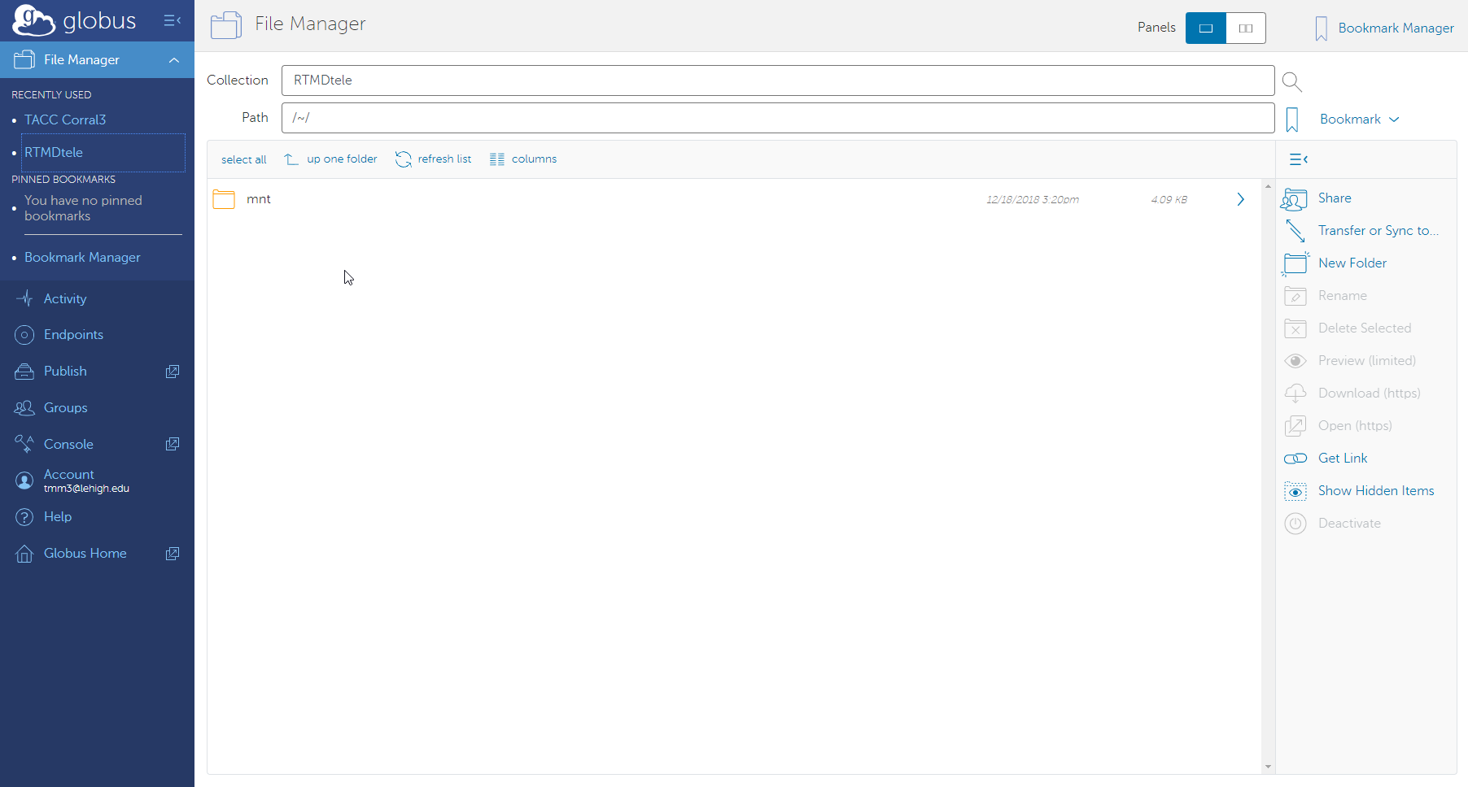
Globus Endpoint Paths

Slide 12
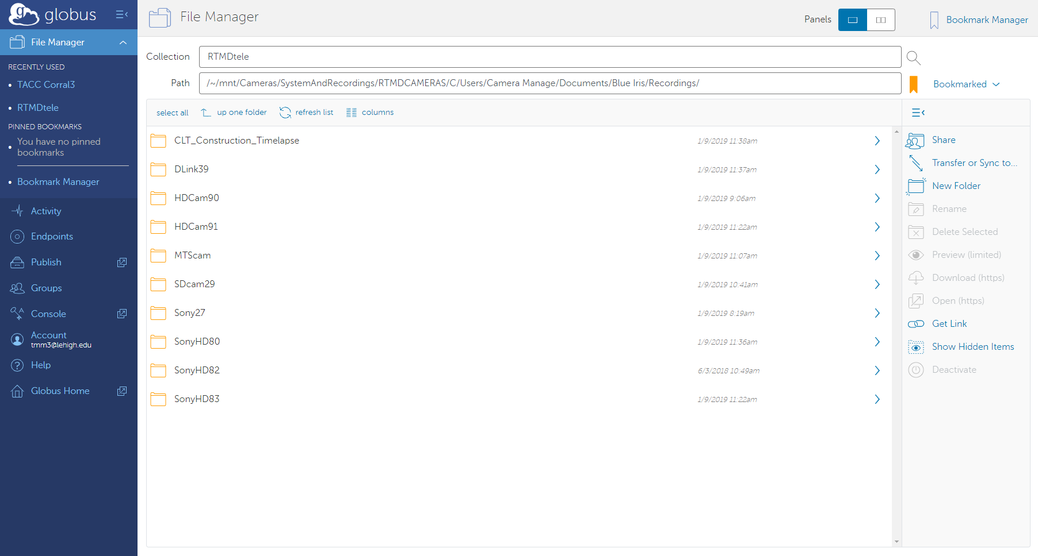
Globus Endpoint Paths

Slide 13
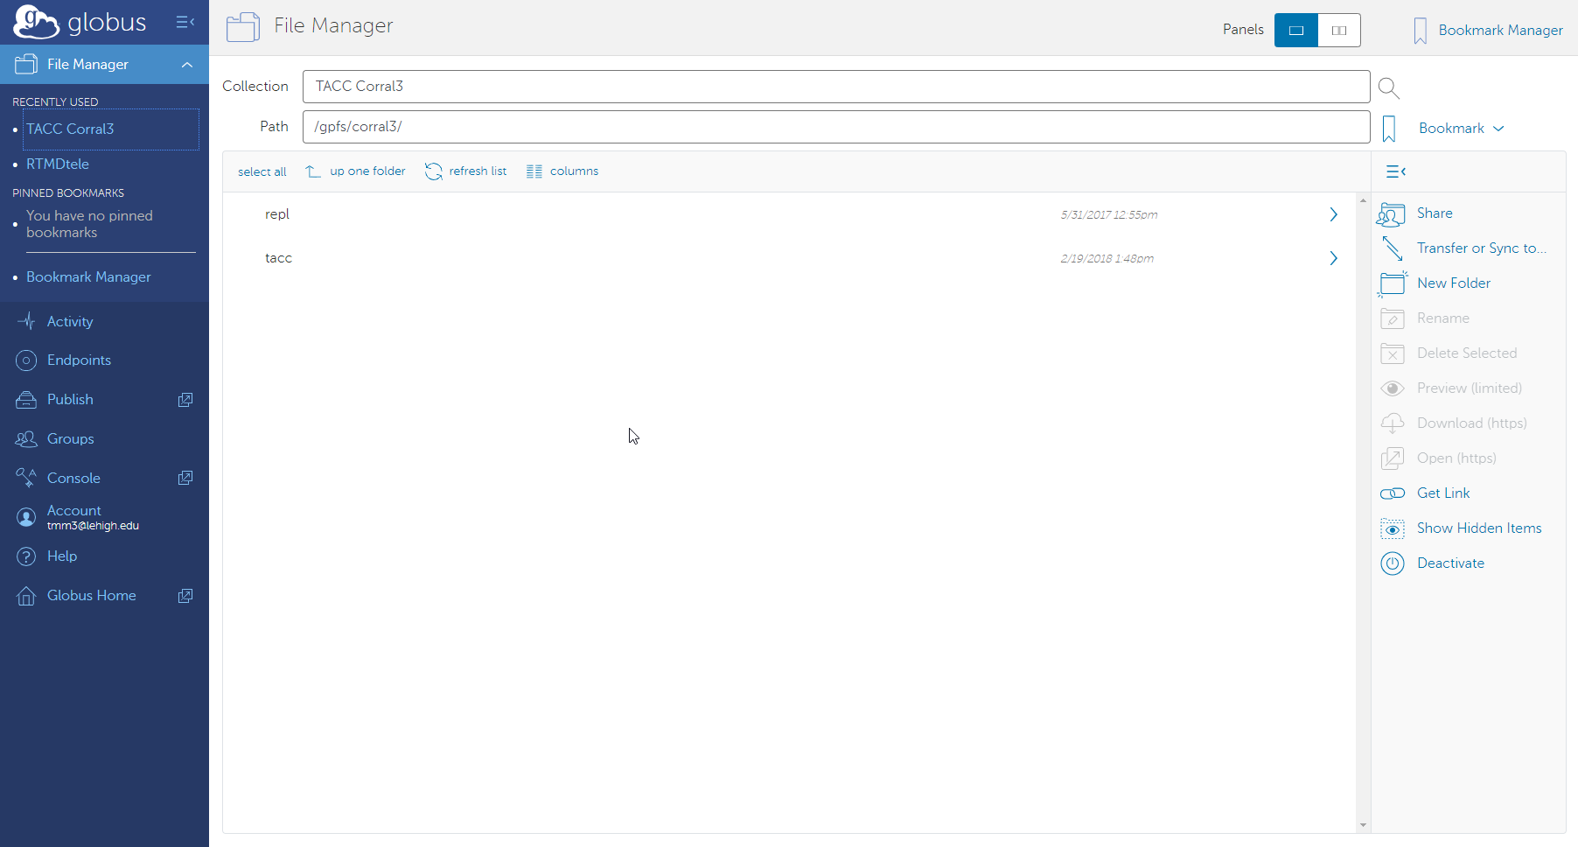
Globus Endpoint Paths
?

Slide 14
TACC/Corral paths for NHERI Users
To access "My Data" set Path to /gpfs/corral3/repl/projects/NHERI/shared/(username)/
To access a project in “Published” set Path to /gpfs/corral3/repl/projects/NHERI/published/PRJ-XXXX/
To access a project in "My Projects" set Path to /gpfs/corral3/repl/projects/NHERI/projects/(Uid)/
?
Source: https://www.designsafe-ci.org/rw/user-guides/globus-data-transfer-guide/

Slide 15
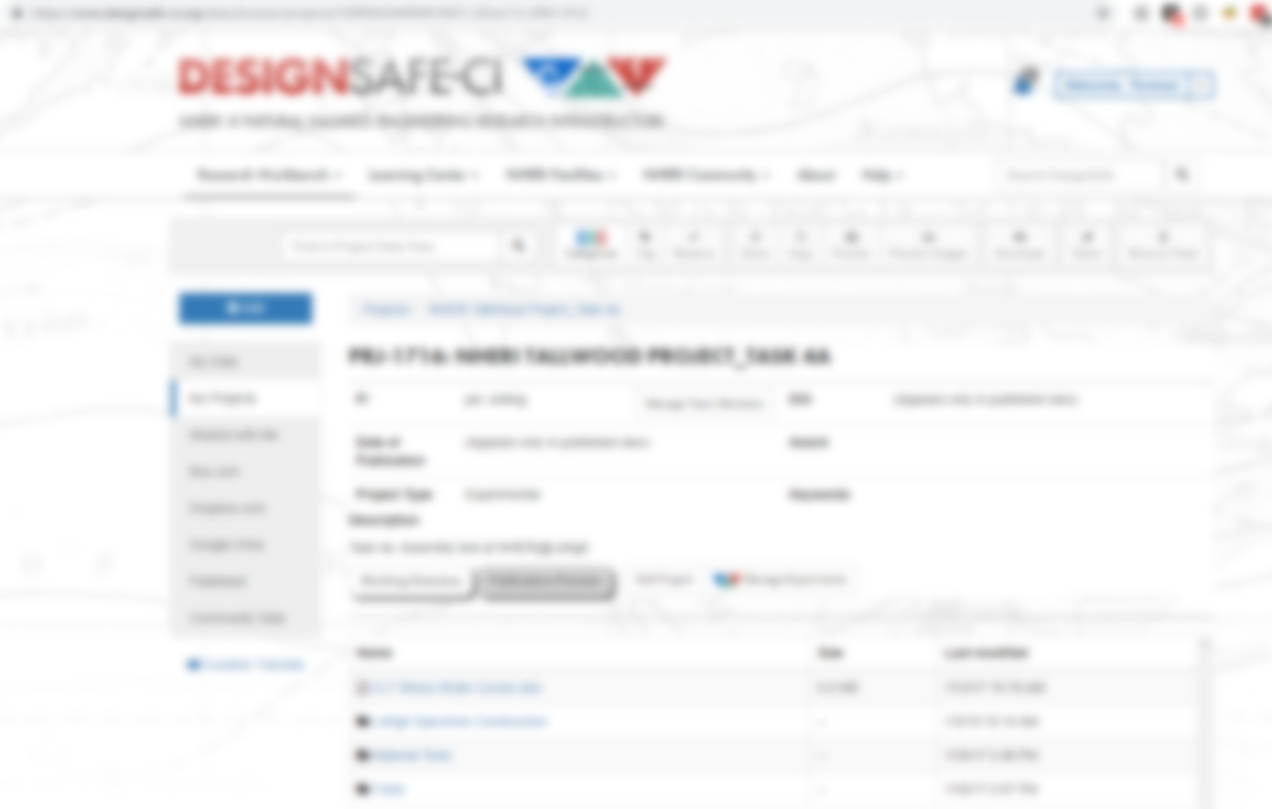


Globus Endpoint Paths

Slide 16
Steps to Automate Globus Transfer
Find Endpoint IDs RTMDtele: ccaaf776-fd82-11e8-9345-0e3d676669f4 TACC: 3f1a4bc6-feb7-11e6-bace-22000b9a448b
Find Endpoint Paths
RTMDtele: /~/mnt/Cameras/SystemAndRecordings/RTMDCAMERAS/C/Users/Camera\ Manage/Documents/Blue\ Iris/Recordings/CLT_Construction_Timelapse/ TACC: /gpfs/corral3/repl/projects/NHERI/projects/1308056344868819431-242ac11c-0001-012/Lehigh\ Specimen\Construction/CLT_Construction_Timelapse/

Slide 17
Steps to Automate Globus Transfer
Find Endpoint IDs RTMDtele: ccaaf776-fd82-11e8-9345-0e3d676669f4 TACC: 3f1a4bc6-feb7-11e6-bace-22000b9a448b
Find Endpoint Paths
RTMDtele: /~/mnt/Cameras/SystemAndRecordings/RTMDCAMERAS/C/Users/Camera\ Manage/Documents/Blue\ Iris/Recordings/CLT_Construction_Timelapse/ TACC: /gpfs/corral3/repl/projects/NHERI/projects/1308056344868819431-242ac11c-0001-012/Lehigh\ Specimen\Construction/CLT_Construction_Timelapse/
Install Globus Personal Connect

Slide 18
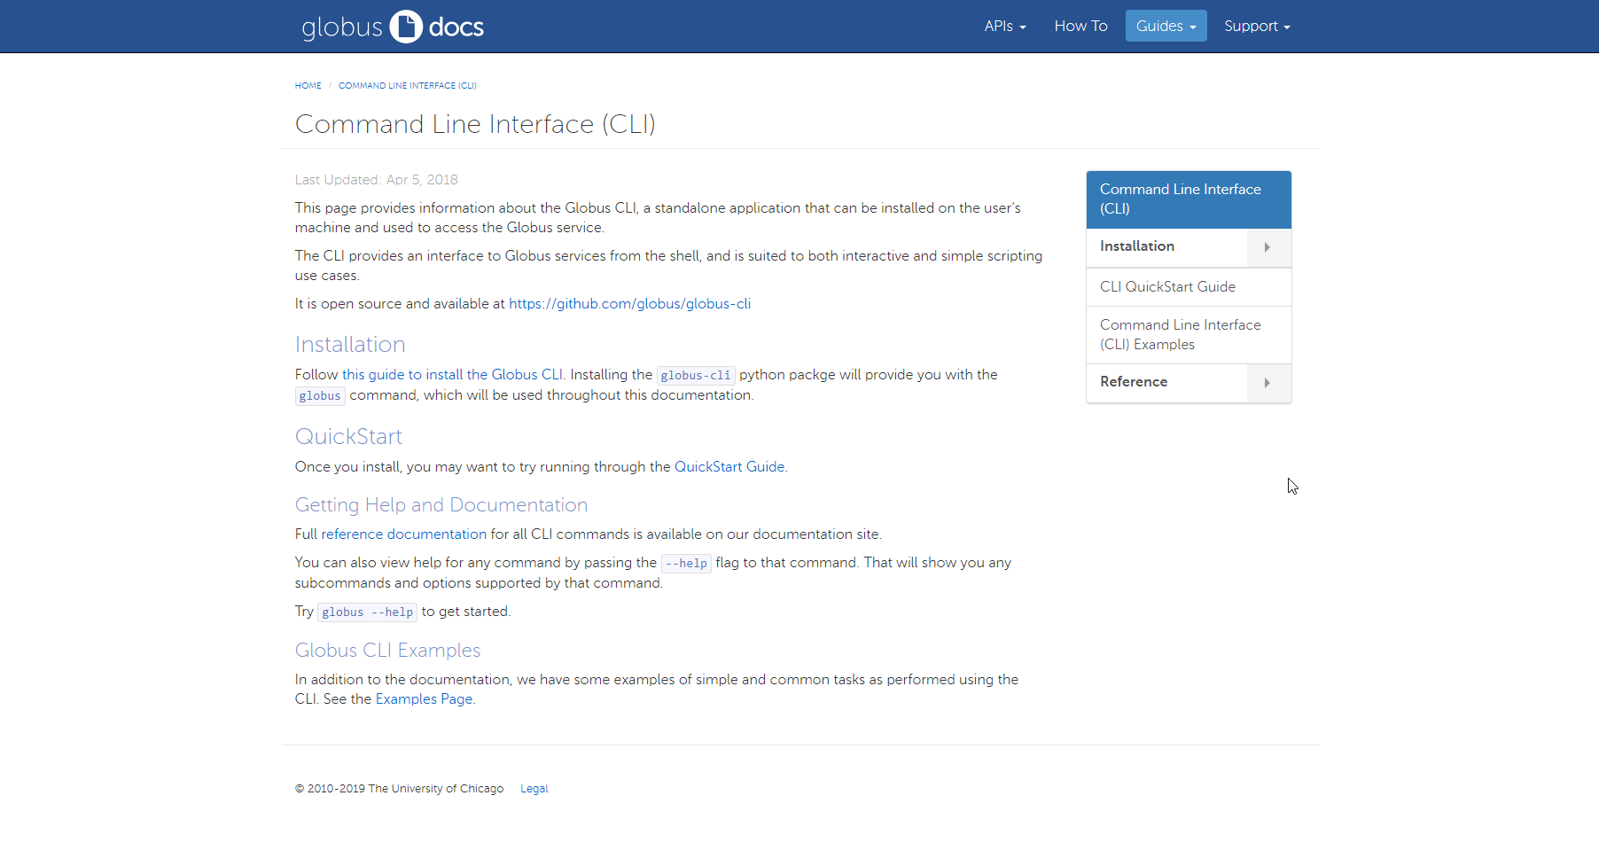
Installing Globus Personal Connect and CLI
https://docs.globus.org/cli/

Slide 19
Steps to Automate Globus Transfer
Find Endpoint IDs RTMDtele: ccaaf776-fd82-11e8-9345-0e3d676669f4 TACC: 3f1a4bc6-feb7-11e6-bace-22000b9a448b
Find Endpoint Paths
RTMDtele: /~/mnt/Cameras/SystemAndRecordings/RTMDCAMERAS/C/Users/Camera\ Manage/Documents/Blue\ Iris/Recordings/CLT_Construction_Timelapse/ TACC: /gpfs/corral3/repl/projects/NHERI/projects/1308056344868819431-242ac11c-0001-012/Lehigh\ Specimen\Construction/CLT_Construction_Timelapse/
Install Globus Personal Connect

Slide 20
Steps to Automate Globus Transfer
Find Endpoint IDs RTMDtele: ccaaf776-fd82-11e8-9345-0e3d676669f4 TACC: 3f1a4bc6-feb7-11e6-bace-22000b9a448b
Find Endpoint Paths
RTMDtele: /~/mnt/Cameras/SystemAndRecordings/RTMDCAMERAS/C/Users/Camera\ Manage/Documents/Blue\ Iris/Recordings/CLT_Construction_Timelapse/ TACC: /gpfs/corral3/repl/projects/NHERI/projects/1308056344868819431-242ac11c-0001-012/Lehigh\ Specimen\Construction/CLT_Construction_Timelapse/
Install Globus Personal Connect
Test CLI Globus Transfer

Slide 21
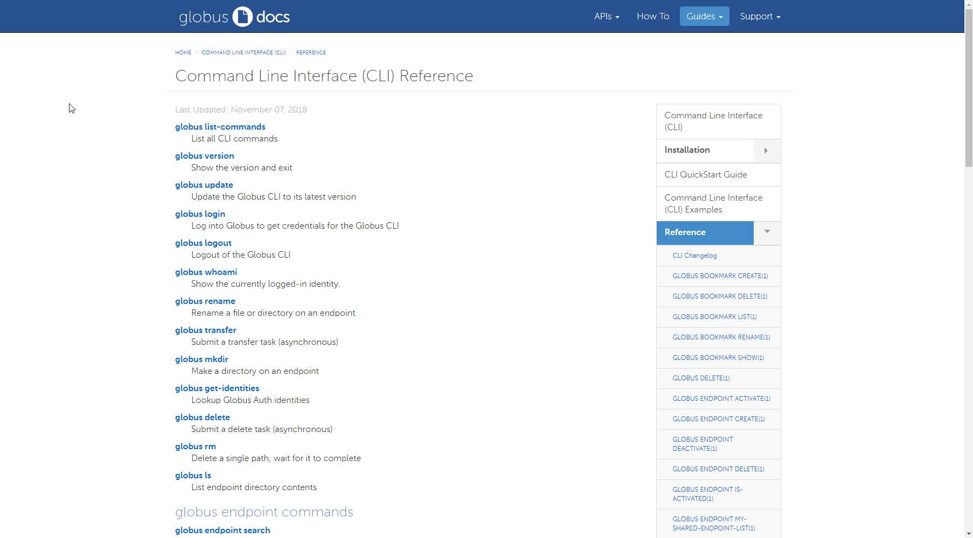
Globus CLI Commands
https://docs.globus.org/cli/reference/

Slide 22
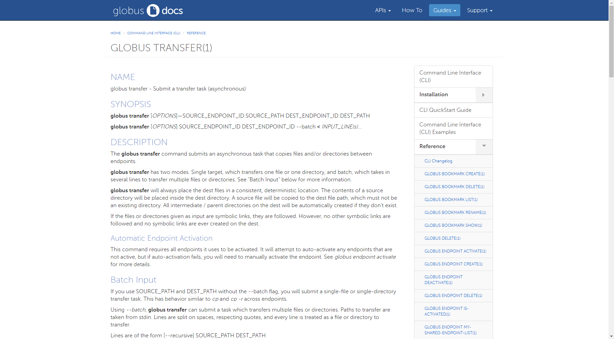
Globus CLI Commands
https://docs.globus.org/cli/reference/transfer/

Slide 23
Globus Transfer
Endpoint IDs RTMDtele: ccaaf776-fd82-11e8-9345-0e3d676669f4 TACC: 3f1a4bc6-feb7-11e6-bace-22000b9a448b
Endpoint Paths
RTMDtele: /~/mnt/Cameras/SystemAndRecordings/RTMDCAMERAS/C/Users/Camera\ Manage/Documents/Blue\ Iris/Recordings/CLT_Construction_Timelapse/ TACC: /gpfs/corral3/repl/projects/NHERI/projects/1308056344868819431-242ac11c-0001-012/Lehigh\ Specimen\Construction/CLT_Construction_Timelapse/
Globus Transfer
$
globus transfer
--recursive
--sync-level size
--no-verify-checksum
--delete
\
“ccaaf776-fd82-11e8-9345-0e3d676669f4:/~/mnt/Cameras/SystemAndRecordings/RTMDCAMERAS/C/Users/Camera\ Manage/Documents/Blue\ Iris/Recordings/CLT_Construction_Timelapse/” \
Open a shell or command line on the system your Globus CLI is installed
checksum
exists
mtime
--batch
“3f1a4bc6-feb7-11e6-bace-22000b9a448b:/gpfs/corral3/repl/projects/NHERI/projects/1308056344868819431-242ac11c-0001-012/Lehigh\ Specimen\ Construction/CLT_Construction_Timelapse/”
Message: The transfer has been accepted and a task has been created and queued for execution
Task ID: ddd1de38-1444-11e9-934a-0e3d676669f4

Slide 24
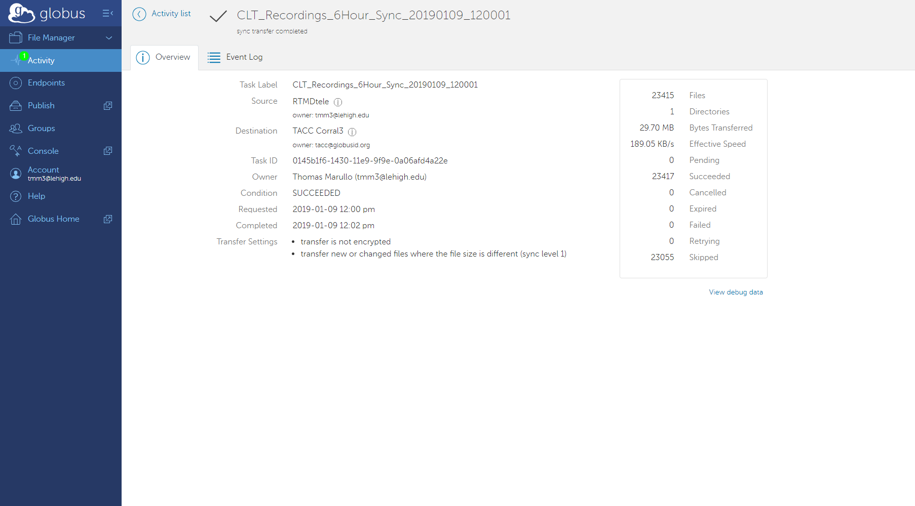
Globus Activity
https://app.globus.org/activity/
Emailed:
TASK DETAILS Task ID: 0145b1f6-1430-11e9-9f9e-0a06afd4a22e Task Type: TRANSFER Status: SUCCEEDED Source: RTMDtele (ccaaf776-fd82-11e8-9345-0e3d676669f4) Destination: TACC Corral3 (3f1a4bc6-feb7-11e6-bace-22000b9a448b) Label: CLT_Recordings_6Hour_Sync_20190109_120001 https://app.globus.org/activity/0145b1f6-1430-11e9-9f9e-0a06afd4a22e

Slide 25
Steps to Automate Globus Transfer
Find Endpoint IDs RTMDtele: ccaaf776-fd82-11e8-9345-0e3d676669f4 TACC: 3f1a4bc6-feb7-11e6-bace-22000b9a448b
Find Endpoint Paths
RTMDtele: /~/mnt/Cameras/SystemAndRecordings/RTMDCAMERAS/C/Users/Camera\ Manage/Documents/Blue\ Iris/Recordings/CLT_Construction_Timelapse/ TACC: /gpfs/corral3/repl/projects/NHERI/projects/1308056344868819431-242ac11c-0001-012/Lehigh\ Specimen\Construction/CLT_Construction_Timelapse/
Install Globus Personal Connect
Test CLI Globus Transfer

Slide 26
Steps to Automate Globus Transfer
Find Endpoint IDs RTMDtele: ccaaf776-fd82-11e8-9345-0e3d676669f4 TACC: 3f1a4bc6-feb7-11e6-bace-22000b9a448b
Find Endpoint Paths
RTMDtele: /~/mnt/Cameras/SystemAndRecordings/RTMDCAMERAS/C/Users/Camera\ Manage/Documents/Blue\ Iris/Recordings/CLT_Construction_Timelapse/ TACC: /gpfs/corral3/repl/projects/NHERI/projects/1308056344868819431-242ac11c-0001-012/Lehigh\ Specimen\Construction/CLT_Construction_Timelapse/
Install Globus Personal Connect
Test CLI Globus Transfer
Automate Globus Transfers

Slide 27
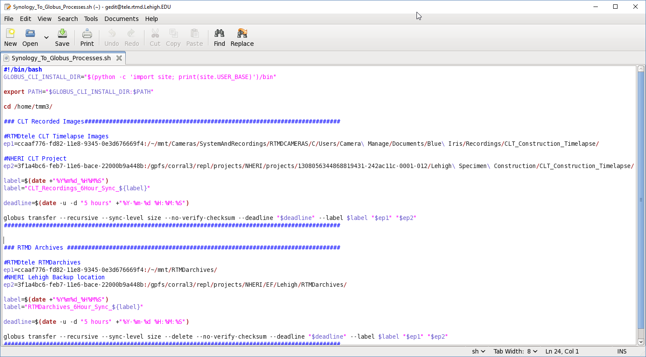
Create Script

Slide 28
Steps to Automate Globus Transfer
Find Endpoint IDs RTMDtele: ccaaf776-fd82-11e8-9345-0e3d676669f4 TACC: 3f1a4bc6-feb7-11e6-bace-22000b9a448b
Find Endpoint Paths
RTMDtele: /~/mnt/Cameras/SystemAndRecordings/RTMDCAMERAS/C/Users/Camera\ Manage/Documents/Blue\ Iris/Recordings/CLT_Construction_Timelapse/ TACC: /gpfs/corral3/repl/projects/NHERI/projects/1308056344868819431-242ac11c-0001-012/Lehigh\ Specimen\Construction/CLT_Construction_Timelapse/
Install Globus Personal Connect
Test CLI Globus Transfer
Automate Globus Transfers

Slide 29
Steps to Automate Globus Transfer
Find Endpoint IDs RTMDtele: ccaaf776-fd82-11e8-9345-0e3d676669f4 TACC: 3f1a4bc6-feb7-11e6-bace-22000b9a448b
Find Endpoint Paths
RTMDtele: /~/mnt/Cameras/SystemAndRecordings/RTMDCAMERAS/C/Users/Camera\ Manage/Documents/Blue\ Iris/Recordings/CLT_Construction_Timelapse/ TACC: /gpfs/corral3/repl/projects/NHERI/projects/1308056344868819431-242ac11c-0001-012/Lehigh\ Specimen\Construction/CLT_Construction_Timelapse/
Install Globus Personal Connect
Test CLI Globus Transfer
Automate Globus Transfers
$ crontab -e
0 */6 * * * /home/tmm3/Synology_To_Globus_Processes.sh > /dev/null

