Slide 1



NHERI Experimental Facilities Publish Your Data Event
Monday December 6, 2021
Revised for NHERI Council meeting, Jan 6, 2022
Recent EF and Project PI Experiences with Data Publication
Daniel Cox
CH2M-Hill Professor of Civil Engineering
Lead PI, NHERI EF at Oregon State
Contributors: Shafiq Alam, Kiernan Kelty, Andrew Kennedy, Chuan Li, Mike Motley, Hyoungsu Park, Jennifer Thornhill, Tori Tomiczek,

Slide 2
Time from End of Data Collection at EF to Final Data Publication (DOI)
(does not represent all NHERI EF activity)
2016
2017
2018
2019
2020
2021
2022
PRJ-1249
PRJ-1740
PRJ-1709
PRJ-2131
PRJ-1306
PRJ-2168
PRJ-3157
PRJ-2143
PRJ-3213
PRJ-3197
PRJ-3218
Testing
Completed
Data
Published
(5 months)
On average, it took TWO YEARS from end of testing to data publication
(30)
NHERI meeting with Tim’s “wall of shame” spreadsheet
(12)
(30)
(22)
Subsequent researchers were uploading data to DesignSafe.org, but they weren’t publishing their data

Slide 3
Time from End of Data Collection at EF to Final Data Publication (DOI)
(does not represent all NHERI EF activity)
2016
2017
2018
2019
2020
2021
2022
PRJ-1249
PRJ-1740
PRJ-1709
PRJ-2131
PRJ-1306
PRJ-2168
PRJ-3157
PRJ-2143
PRJ-3213
PRJ-3197
PRJ-3218
Testing
Completed
Data
Published
(5 months)
(30)
Get PI commitments to publish their data
(12)
Solution:
(1) talk with Maria and DesignSafe Team, and
(2) talk with project PIs to get commitment
(30)
(22)
(44) [6]
(31) [1]
(30) [3]
On average, it took THREE MONTHS from PI commitment to data publication
(29) [3]
(28) [4]
(7) [2]

Slide 4
Long term Solution, Part 1
Re-evaluate our EF workflow
Funded Project Phase
Year 1 Year 2 Year 3
Researcher’s timeline
Physical Modeling Phase:
EF’s timeline
wrt to the project
Physical Modeling Phase:
Another
researcher’s timeline

Slide 5


Get PI “commitment” for data publication
Loop in DesignSafe team
Check in with PI team
Increase awareness of tools
  Online tutorials
  Check list
  Publish Your Data Events
Long term Solution, Part 1
Re-evaluate our EF workflow
Funded Project Phase
Year 1 Year 2 Year 3
Researcher’s timeline
Physical Modeling Phase:
EF’s timeline
wrt to the project
Physical Modeling Phase:
Another
researcher’s timeline
Give feedback to your EF!

Slide 6
Long term Solution, Part 2
Build “Best Practices”
We asked recent researchers for these three things
1
What are the “top 3” lessons learned or things you would want others to know about the data curation process (getting data published to “DOI” status)?
What are the “top 3” things you wish you had done differently from the start of your funded NSF project, including designing and conducting experiment at HWRL and data archival after ending experiments, to improve the final curated project?
2
3
Any other “do’s and don’ts” that would help researchers in publishing their data from HWRL.

Slide 7
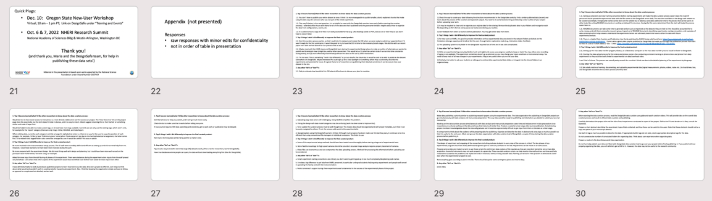
Thanks to researchers who provided feedback!!
Name | Position | Affiliation | DOIs
Hyoungsu Park | Asst. Professor | U. Hawaii | 10.17603/ds2-w6cr-s920; 10.17603/ds2-8evm-1y60
Shafiq Alam* | Post-doc | U. Notre Dame | 10.17603/ds2-v287-t615
Andrew Kennedy | Professor | U. Notre Dame | 10.17603/ds2-8ape-v659
Tori Tomiczek | Asst. Professor | US Naval Academy | 10.17603/ds2-znjw-1f81
Kiernan Kelty** | Engineer | CBEC eco | 10.17603/ds2-j0j1-5827
Chuan Li* | Post-doc | UCLA | 10.17603/ds2-xrre-y741
Mike Motley | Assoc. Professor | U. Washington | 10.17603/ds2-q2w5-0t48; 10.17603/DS2T09V
*post-doc at Oregon State at start of data curation
** grad student at Oregon State at start of data curation
Appendix A: Full responses. Lots of great information!!

Slide 8
User Responses:
#1 Comment: Talk with Maria and DesignSafe Team (early)
It is so helpful to meet with the DesignSafe curation team early (before starting the curation process).
I attended office hours with Maria for all data sets that I published, and she gave some fantastic insights about how to organize the data from configurations, events, etc.
Ask Maria Esteva to help you publish, and it will go much more easily.
DO attend office hours to discuss your plan for curation.

Slide 9
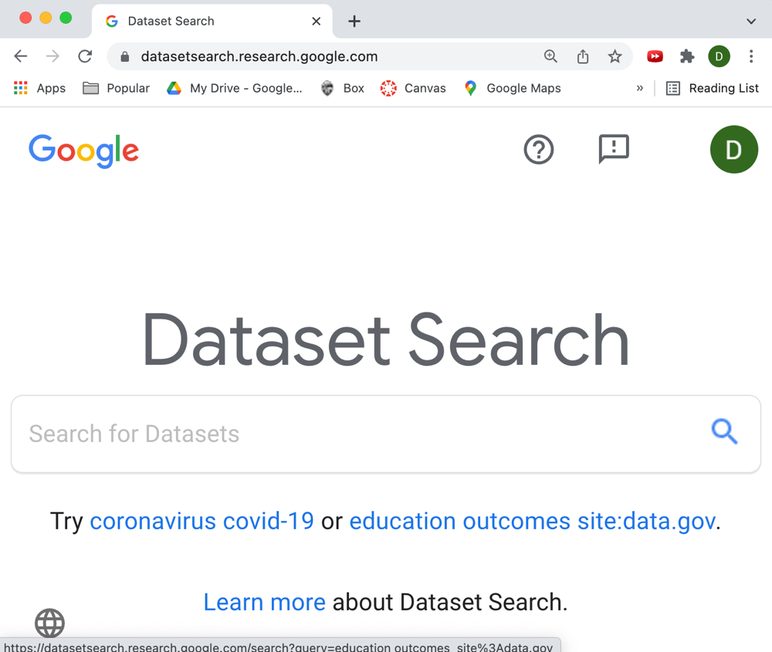
What are the “carrots” for the user’s? Thinking about Data Publication, Data Searches, etc.
Google Dataset Search engine. Similar to Google Scholar in that it filters out non-datasets.
Example: searching for tsunami debris data sets
tsunami debris

Slide 10
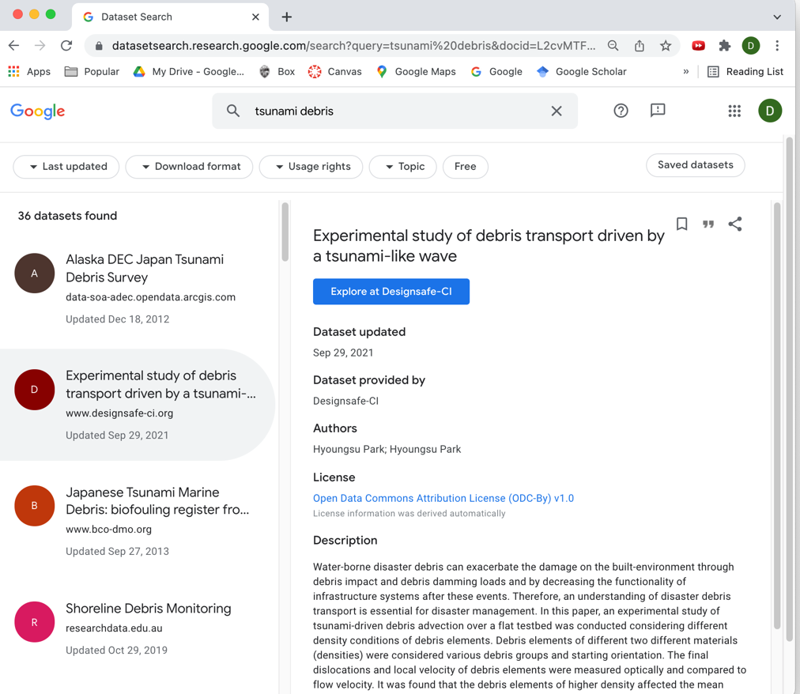
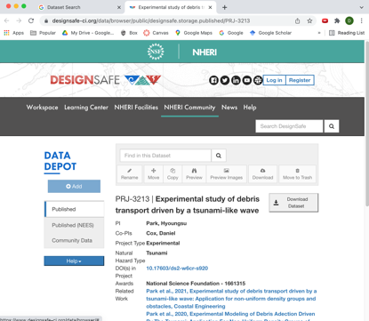


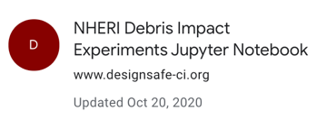
Searching for “tsunami debris” reveals 36 published data sets
Second on the list is recent (9/2021) data set from EF on DesignSafe.org
Linked to DesignSafe.org
Scroll down to find more…

Slide 11
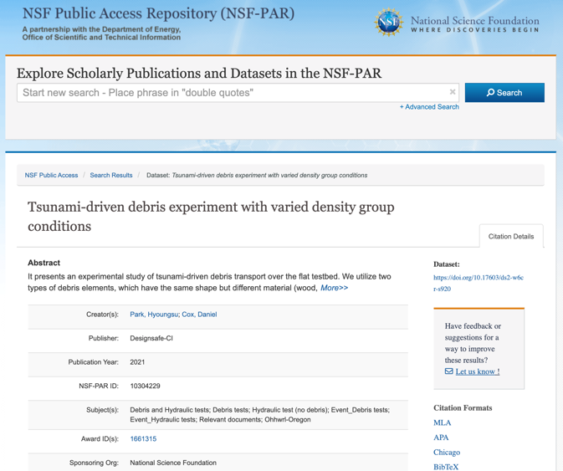
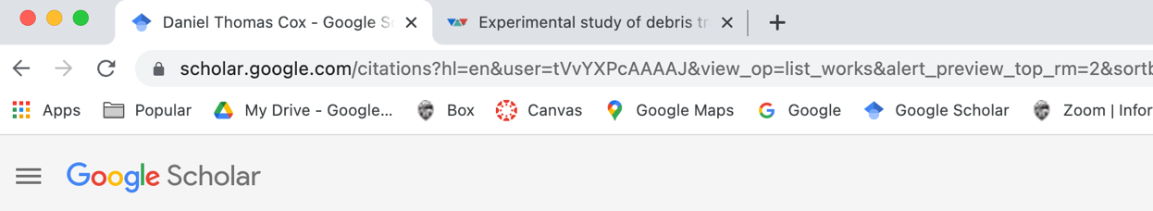
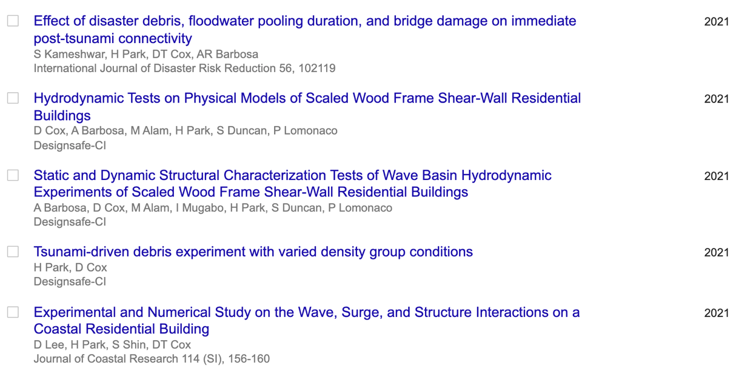
… to NSF Public Access Repository (PAR)…
And from Google Scholar
. . . then to DesignSafe.org

Slide 12
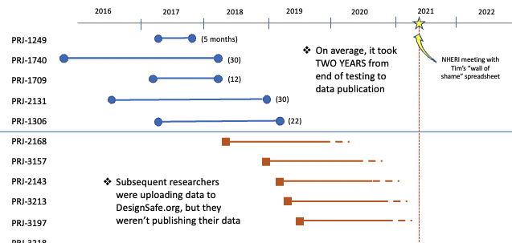
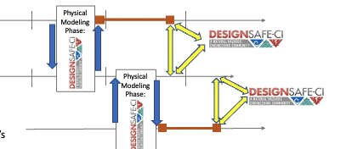
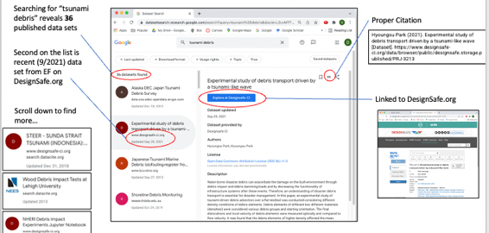
Summary
Data uploading isn’t data publishing
Data publishing requires
  User commitment
  EF collaboration/intervention
  DesignSafe team consultation
Emphasis on “carrots”
  Connecting data and papers
  Google Dataset Search, Google Scholar
  NSF Public Access Repository
Next up: Data reuse!

Slide 13
Appendix (not presented)
Responses
raw responses with minor edits for confidentiality
not in order of table in presentation
Ideas come from the users. Give feedback to EF and to DesignSafe!
  Improvements to data archiving and data sharing
  Larger network of users
  Shared experiences, lessons learned

Slide 14
1. Top 3 lessons learned/what I’d like other researchers to know about the data curation process:
1.1: You don’t have to publish your entire dataset at once. I think it is more manageable to publish smaller, clearly explained chunks that make using the data easy for someone who was not part of the initial experiment.
1.2: This may fit better in the next question- it is so helpful to meet with the DesignSafe curation team early (before starting the curation process). I attended office hours with Maria for all of the data sets that I published and she gave some fantastic insights about how to organize the data from configurations, events, etc.
1.3: It is useful to have a copy of all files in an easily accessible format (e.g. CAD drawings saved as PDFs, data as csv or text files) so you don’t have to convert later.
2. Top 3 things I wish I did differently to improve the final curated product:
2.1: Start the curation process earlier, so that I could cite the dataset and include the DOI when we were ready to submit our paper(s). Even if it wasn’t ready for the first submission, it would be good to try to have the DOI in time for the revisions/proofs stages. We did this with our recent paper and I wish we had done it for our previous test as well.
2.2: Maybe meet with the HWRL team and DesignSafe team during the experimental design phase to make an outline of what data we wanted to publish and brainstorm how it might be used by other researchers. This would let us (1) prioritize certain trials if we ran into time constraints during testing and (2) more effectively disseminate/publicize the data set for use by other researchers.
2.3: I’m not sure if this is something “I wish I did differently” or just an idea for the future but it would be cool to be able to publicize the dataset somewhere on DesignSafe. Maybe interested PIs could sign up for a Data Spotlight or something where they could briefly describe the experiments and potential for reuse. It is great that a lot of researchers are publishing their data but sometimes it can be easy to lose your dataset in the mix.
3. Any other “do”s or “don’t”s:
3.1: Only to reiterate how beneficial it is: DO attend office hours to discuss your plan for curation.

Slide 15
1. Top 3 lessons learned/what I’d like other researchers to know about the data curation process:
1) Check the way to curate your data following the directions recommended in the DesignSafe carefully. Find a similar published data (recent) and learn about the process of the curation and expected outputs. You need to do some brainstorming and develop a clear outline of your project before uploading your work.
2) It may be required to clean and re-organize your original data for the sharing: Remove the duplicated data in your folders and re-organize each file depending on file’s format and purposes (or tasks) considering your outline.
3) Get feedback from other co-authors before publication. You may get better data from them.
2. Top 3 things I wish I did differently to improve the final curated product:
1) For new users at HWRL, it is good to provide information on how experimental data are stored in the network folders and what are the limitations (storage capacity and timeline) for the users through better explanation tools (e.g., Animation slides, YouTube).
2) The uploading system to my folder in the Designsafe required lots of time and it was a bit complicated.
3. Any other “do”s or “don’t”s:
1) Write an experimental log every day (before lunch and night) and assess your progress weekly to keep on track. You may utilize voice recording if typing is not available. The experiment sometimes doesn’t go as planned, so you may change your input conditions or instrumental setup. You need to keep track of all new changes in your experiments. A log is very useful when you re-visit your data.
2) Similarly, it is better to ask your students or colleague to archive daily experimental data (video or images) into the shared folders in an organized way.

Slide 16
1. Top 3 lessons learned/what I’d like other researchers to know about the data curation process:
1.1). Setting a consistent and clear naming convention before starting experiments will make the data curation process easier down the road. EF personnel would upload the experimental data with the file names to the DesignSafe server daily. This was then available on the design safe website to be curated accordingly. Changing file names can be done on the website but is laborious and adds additional time to the process that can be spent on other tasks like writing README documents or working on dataset file structure. Having the file name determined from the start will make the process easier later on.
1.2). README documents can take some time to generate and are just as important as the datasets they are tied to.Time should be accounted for to write, review, and edit them among the research group. A good set of README documents describing experiments, naming convention, and examples of data contained within helps viewers understand the experiments better and ultimately determine how to utilize the data with future experiments/analysis.
1.3). There is a helpful Data Curation and Publication User Guide published by NHERI Design safe found here: https://www.designsafe-ci.org/rw/user-guides/data-curation-publication/ There is also a great video playlist published by DesignSafe that walks you through the publication process from start to finish in a set of 7 short videos (~ 30 s - 1 min). https://youtube.com/playlist?list=PL2GxvrdFrBlkwHBgQ47pZO-77ZLrJKYHV
2. Top 3 things I wish I did differently to improve the final curated product:
2.1). Setting up the mass data transfer program, Globus, on a laboratory computer so the mass data transfer process would be faster to DesignSafe.
2.2). Starting the data upload process for the videos and photos sooner. Also conducting consistent naming on phone videos and photos from daily experiments so they could be easily linked to experimental run data/overhead video.
I can't find a 3rd one. The process was overall pretty smooth for me which I think was due to the detailed planning of the experiments by the group.
3. Any other “do”s or “don’t”s:
3.1) Set a daily routine of naming, documenting, and uploading experimental data (signal measurements, photos, videos, notes etc..) to local drives, box, and DesignSafe streamline the curation process (months) later.

Slide 17
1. Top 3 lessons learned/what I’d like other researchers to know about the data curation process:
Would be nice to have easier access to instruction, i.e. more directly visible when we first access our project. The ‘View Overview’ link on the project page does this essentially, but the term doesn’t make it obvious, and it is easy to miss it. Would suggest renaming this to ‘Get Started’ or something similar and make it larger font.
Would be helpful to be able to create custom tags, or at least have more tags available. Currently we can only use the existing tags, which aren’t a lot, for example for the ‘report’ category (there are only 3 tags: Other, README, and Data Report.
When relating data, currently each category is strictly arranged in alphabetical order, i.e. there is no way for the user to swap the position of each category. For example, I’d like to have ‘Preliminary tests’ come before ‘Final scenarios’, but due to the hard alphabetical arrangement, the latter comes first. On a related note, tagged folders also cannot be arranged by user. It would be useful if this was an option.
2. Top 3 things I wish I did differently to improve the final curated product:
Be more involved in the instrumentation setup process. The EF staff were incredibly skilled and efficient at setting up and did not need help from me. However, I could have learned a lot had I been more involved during this part.
Be more prepared with the experiment design. We did most things well with design and planning, but I could have been more well-versed on the particular wave-maker theory we were using, for example.
Asked for more input from the staff during all phases of the experiment. There were instances during the experiment when inputs from the staff proved very beneficial. I am certain that other aspects of the experiment would have benefited even further had I asked for more input more often.
3. Any other “do”s or “don’t”s:
It was definitely helpful to look at previously published projects to learn how best to curate data. Still, every project is different, so it helps to think about what would and wouldn’t work in curating data for my particular experiment. Also, I find that keeping the organization simple and easy to follow, as opposed to complicated but detailed, worked well.

Slide 18
1. Top 3 lessons learned/what I’d like other researchers to know about the data curation process:
Get Maria Esteva to help you publish, and it will go much more easily.
Check the doi to make sure that it works before telling everyone.
If your journal requires FAIR data publishing and standards, get to work early or publication may be delayed.
2. Top 3 things I wish I did differently to improve the final curated product:
Not much. Archiving data will be fairly painful no matter what.
3. Any other “do”s or “don’t”s:
FIgure out a way to transfer extremely large (TB) datasets easily. (This is not for researchers, but for DesignSafe).
Have true databases where people can query the data without downloading everything first (Also for DesignSafe).

Slide 19
1. Top 3 lessons learned/what I’d like other researchers to know about the data curation process:
a. Uploading large data sets is still challenging. Using GLOBUS simplifies the problem.
b. Fitting the design-safe data model categories may be confusing (work has been done to improve this).
c. To be usable the curation process must be well thought out. This means data should be organized and with proper metadata, such that it can be easily navigated by others. If not, the process adds work to the experimentalist.
d. Navigating data using the DesignSafe portal is limited. Although much progress has been made over the last few years, it continues to be less efficient than using conventional file managers in individual computers. This limits its use.
2. Top 3 things I wish I did differently to improve the final curated product:
a. Some of the experimental setup methods should have been tested more thoroughly before starting a large set of experimental tests.
b. More flexible mountings for high speed cameras should be provided. Accurate Image analysis requires proper placement of cameras.
c. Video files can be enormous and can compromise the data uploading process. Methods for processing this information before uploading can be considered.
3. Any other “do”s or “don’t”s:
a. Smart experiment naming conventions are critical; you don’t want to get tripped up in too much complexity/deciphering code names
b. It makes a big difference to get help from HWRL personnel; in particular undergrad students helping setup experiments and people well versed in operating the facility and with the instrumentation.
c. Pedro Lomanoco’s support during these experiments was fundamental in the success of the experimental phase of the project.

Slide 20
1. Top 3 lessons learned/what I’d like other researchers to know about the data curation process:
Make data publishing a priority similar to publishing research papers using the experimental data. The data organization for publishing in DesignSafe project can go simultaneously with data analysis and manuscript preparation. This way data would be ready for publishing and cited when you decide to submit your journal manuscript.
Working on the data curation process simultaneously with data analysis and manuscript preparation saves time and reduces error in data preparation since researchers are actively working on the data and know their data much better than if data is curated at a later stage after journal publication. Sometime key project members knowledgeable about the data will graduate and it becomes exponentially difficult to get input from them on the data at a later stage.
It is important to think about the audience while preparing data for publishing. Organize and describe the data in abstract and using tags as much as possible so that it is useful to the end users. Meet and go over the data organization with data curation lead of DesignSafe a couple of times during the data curation process before publishing it.
2. Top 3 things I wish I did differently to improve the final curated product:
The design of experiment and engaging all the researchers including graduate students in every step of the process is critical. The key phases of any experimental program should be clearly defined and agreed upon to avoid any confusion in the lab. Adjustments can be made on an adhoc basis.
Prepare some scripts and make it a norm to use those scripts for preliminary data analysis of the raw data as they are recorded. Sometime one or two data acquisition channels/instruments may not work properly in a given day. These raw data analysis scripts can help monitor the malfunctions real-time and help researchers to address the problems and repeat the trials if necessary without losing valuable data. Nothing can be done if the problem is detected at a later date when the experimental program is over.
Not everything goes according to plan in the lab. There should always be some contingency plans and reserve days.
3. Any other “do”s or “don’t”s:
(next slide).

Slide 21
3. Any other “do”s or “don’t”s:
Before starting the data curation process, read the DesignSafe data curation user guide and watch curation videos. This will provide idea on the overall data curation process and result in efficient data curation and publishing.
Carefully think about the project title and the title of each experiments conducted as a part of the project. Talk to the PI’s and decide on it. Also, consult the keywords.
Prepare a short abstract describing the experiment, type of data collected, and how those can be useful to the users. Note that these abstracts should not be a copy and paste of your manuscript abstract.
Use built-in tag as much as possible to describe the data. If appropriate builtin tags do not exist, create appropriate descriptive tags for the data.
Do not use excessive number of convoluted folders for organizing data. Think about user experience when organizing data.
Prepare a read-only file describing overall data organization.
Do not hurriedly publish your data set. Meet with DesignSafe data curation lead to go over your project before finally publishing it. If you publish without properly organizing the data, you will definitely get a DOI for it. However, the data may not be useful to the research community.

