Slide 1

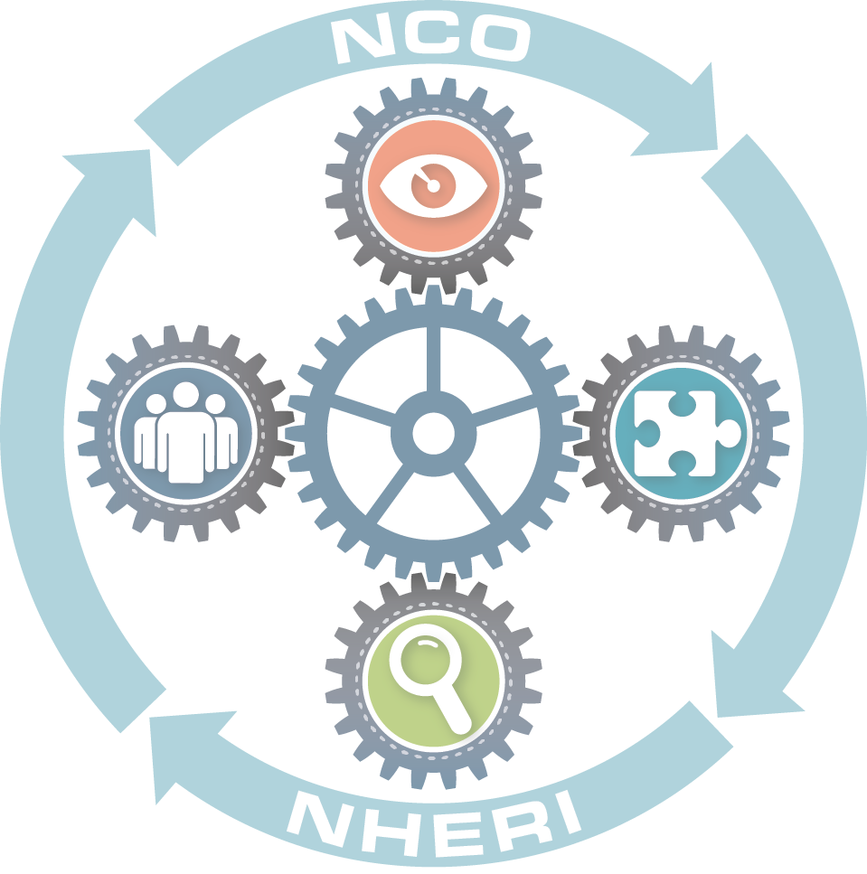
PROJECTS IN NHERI¹
Facility | NSF (Utilization Days²) | Other Federal/State Agencies or Industry in NHERI Time | Non-NHERI Time
Oregon State U. | 7 (311) | 2 | 1
UC Davis | 7 (287) |  | 1
UC San Diego | 3 (230) |  | 1
Lehigh University | 11 (398)
FIU | 11 (225) |  | 4
U. of Florida | 12 (269) | 1
UT Austin | 4 (252) |  | 1
Total | 55 | 3 | 8
¹Tracked by NCO since implementation of centralized scheduling
on 2/1/17 to 12/31/17
² Some facilities have concurrent projects
Slide 14

