Slide 1

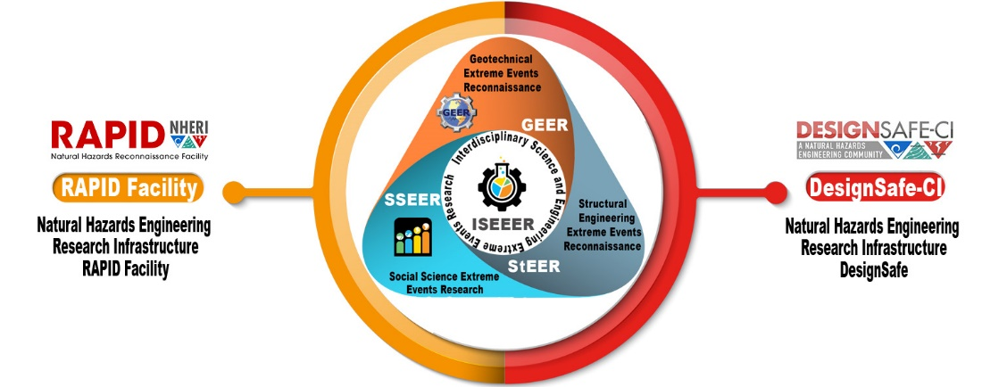


CONVERGE
Coordinated Social Science, Engineering, and Interdisciplinary Extreme Events Research
A National Science Foundation-Natural Hazards Engineering Research Infrastructure (NSF-NHERI) Resource
Lori Peek, Ph.D.
Professor, Department of Sociology
Director, Natural Hazards Center
University of Colorado Boulder
Notes:
Hello everyone. This is Lori Peek writing here, and I am so sorry that I cannot be there to join with you today. However, I am teaching a large 420+ student Introduction to Sociology course this semester, and it is during this time block!
Please know how grateful I am for Julio, who agreed to offer this brief overview and introduction to CONVERGE, SSEER, and ISEEER. The NSF Program Director for these grants, Robin Dillon-Merrill, is also on the call today and she has kindly offered to help track and respond to any questions or comments.

Slide 2
Outline
Brief Introduction to CONVERGE
Update on SSEER
Overview of ISEEER
Notes:
Per Julio’s request, the objective of this presentation is to offer a brief introduction to CONVERGE, while also providing an update on the SSEER and ISEEER networks and platforms.
First, though, I wanted to note that I have had the honor of serving on the NHERI Scientific Plan Advisory Committee, and also on the NHERI RAPID Facility Scientific Advisory Committee. As such, I have been following the work of NHERI for some time – with great admiration and respect. It is a great pleasure to have this opportunity to share this information with you today.

Slide 3
What is Convergence?
Convergence research tends to be driven by a specific and compelling problem—such as rising disaster losses—and it requires the integration of knowledge, theories, methods, and expertise from different disciplines—such as within the social sciences and engineering—to achieve scientific breakthroughs that otherwise would not be possible. Convergence research is designed to catalyze scientific discovery and innovation while also helping to solve complex societal issues and environmental challenges (see National Research Council 2014).
Notes:
To begin, a few words on Converge research, which is one of the National Science Foundations “10 Big Ideas”.
Please read Slide 3

Slide 4
What is Convergence?
Convergence represents a coming together – for the first time – of the NSF-EER platforms and the NHERI facilities
Notes:
In this specific instance, convergence is meant to denote a coming together of the engineering and social science communities through the NSF-supported extreme events research and reconnaissance networks, as well as the NHERI network. These communities have long been concerned with understanding and reducing hazards losses. The intent of CONVERGE is, in part, to advance the disciplinary and interdisciplinary scientific enterprise, while also to broaden engineering and social science applications.

Slide 5
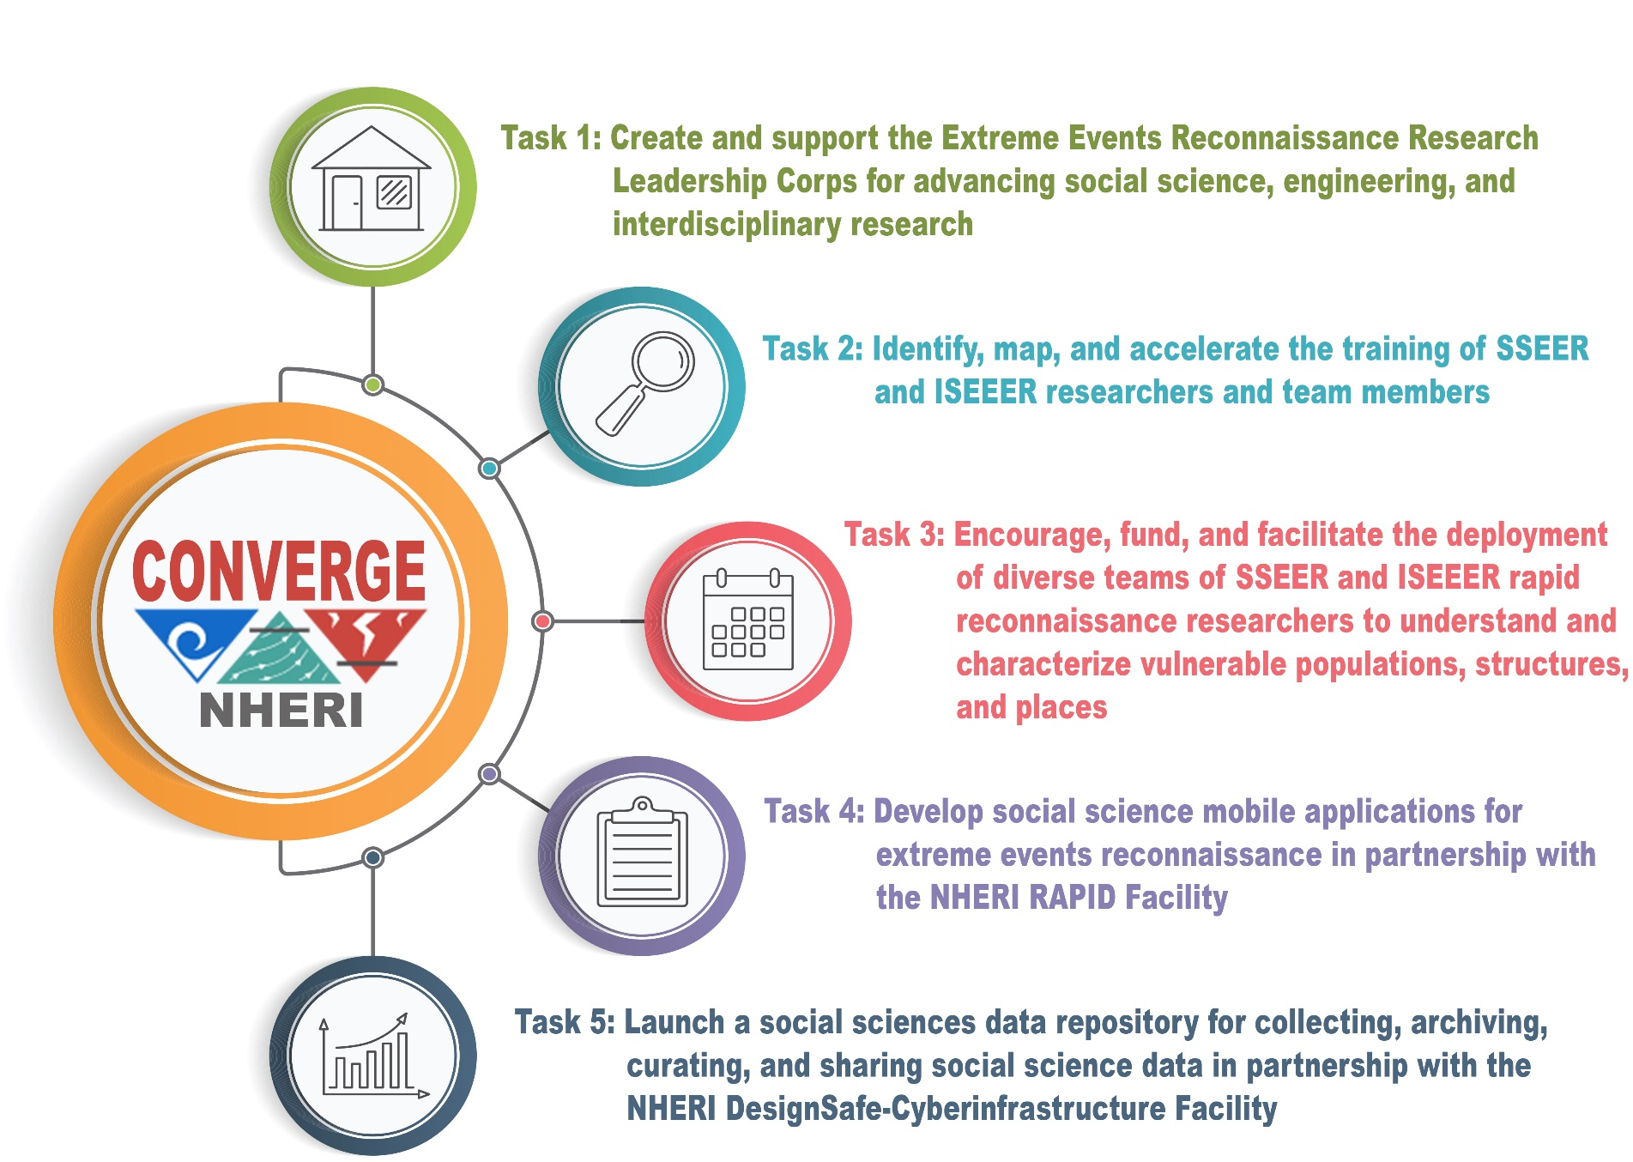

CONVERGE
Coordinated Social Science, Engineering, and Interdisciplinary Extreme Events Research
A National Science Foundation-Natural Hazards Engineering Research Infrastructure (NSF-NHERI) Resource
Notes:
CONVERGE was awarded one month ago to the day by NSF as a research grant.
There are five major tasks that are associated with CONVERGE, including:
Task 1: Create and Support the first-ever Extreme Events Reconnaissance Research Leadership Corps.
This Leadership Corps will include the leaders of GEER (David Frost), StEER (Tracy Kijewski-Correa), SSEER, and ISEEER (Lori Peek), RAPID (Joe Wartman and Jeff Berman), DesignSafe (Ellen Rathje).
The Leadership Corps is tasked with developing various best practice guidelines for reconnaissance research.
In addition, through CONVERGE, we will be working with the Center for Environmental Journalism at CU Boulder to advance the communications around the science of hazards and disaster research, especially during major deployments.
Task 2: Identify, map, and accelerate the training of social science and interdisciplinary researchers through SSEER and ISEEER.
In addition to the identifying and mapping of researchers, we will be developing a variety of training modules through CONVERGE focused on issues such as:
IRB Ethics Vulnerable Populations Mental Health
Task 3: Encourage and fund the deployment of SSEER and ISEEER Researchers – especially with a focus on the most vulnerable people and places.
Task 3 involves a partnership with the Bill Anderson Fund and the NSF INCLUDES Minority Surge Capacity in Disasters group, to ensure that next generation scholars from historically underrepresented groups will have the opportunity to contribute.
Task 4: Work with the NHERI RAPID Facility to advance mobile applications for social science and interdisciplinary reconnaissance.
Task 5: Collaborate with NHERI DesignSafe-Cyberinfrastructure to build a social science and interdisciplinary data model.
In the interest of time, this presentation will not go into great depth with any one of these tasks, but please know that there are many subtasks and deliverables associated with each one of these tasks.

Slide 6


Update on SSEER and ISEEER
Notes:
As noted on the prior slide, several of the Tasks and Deliverables associated with CONVERGE involve further advancing the Social Science Extreme Events Research and the Interdisciplinary Science and Engineering Extreme Events Research platforms and networks that we are establishing for social science and interdisciplinary research communities.

Slide 7
Please read this brief statement: “A Call to Social Scientists” for more background and context on SSEER (hazards.colorado.edu/news/director/a-call-to-social-scientists)
The form to join SSEER has been live since July (hazards.colorado.edu/join-SSEER)
At present, nearly 300 social scientists have completed the 7-minute survey! This information will allow us to generate the first census of the social science hazards and disaster community, while also sharing more detailed information about the diverse disciplinary, methodological, and topical forms of expertise in the community.
SSEER will also fund rapid reconnaissance efforts led by social scientists and among those working in interdisciplinary teams.
Notes:
If you are interested in learning more about the background and motivation for SSEER, I hope you will read the brief statement from Lori, describing SSEER. The link is at the top of the screen.
The form to join SSEER – and the open call to social scientists – has been live since July. Please share the Jon SSEER link with your social science friends and family members! ☺
As of today, nearly 300 social scientists have completed the SSEER survey. This will lead to the first-ever “census” of the social science hazards and disaster research community, and will also allow us to analyze and share information on the various forms of expertise among the community.
SSEER will also fund rapid reconnaissance efforts led by social scientists and among those working in interdisciplinary teams.

Slide 8
Now that the SSEER survey form is live, a next step is to:
Open a call for researchers who are interested in joining interdisciplinary reconnaissance teams and to
Develop a database of researchers who have regularly engaged in interdisciplinary hazards and disaster research.
The Science of Team Science will inform all subsequent modules and resources that are developed to help foster interdisciplinary collaboration.
Notes:
Now that the SSEER survey form is live, a next step is to:
Open a call for researchers who are interested in joining interdisciplinary reconnaissance teams and to
Develop a database of researchers who have regularly engaged in interdisciplinary hazards and disaster research.
The Science of Team Science will inform all subsequent modules and resources that are developed to help foster interdisciplinary collaboration.

Slide 9
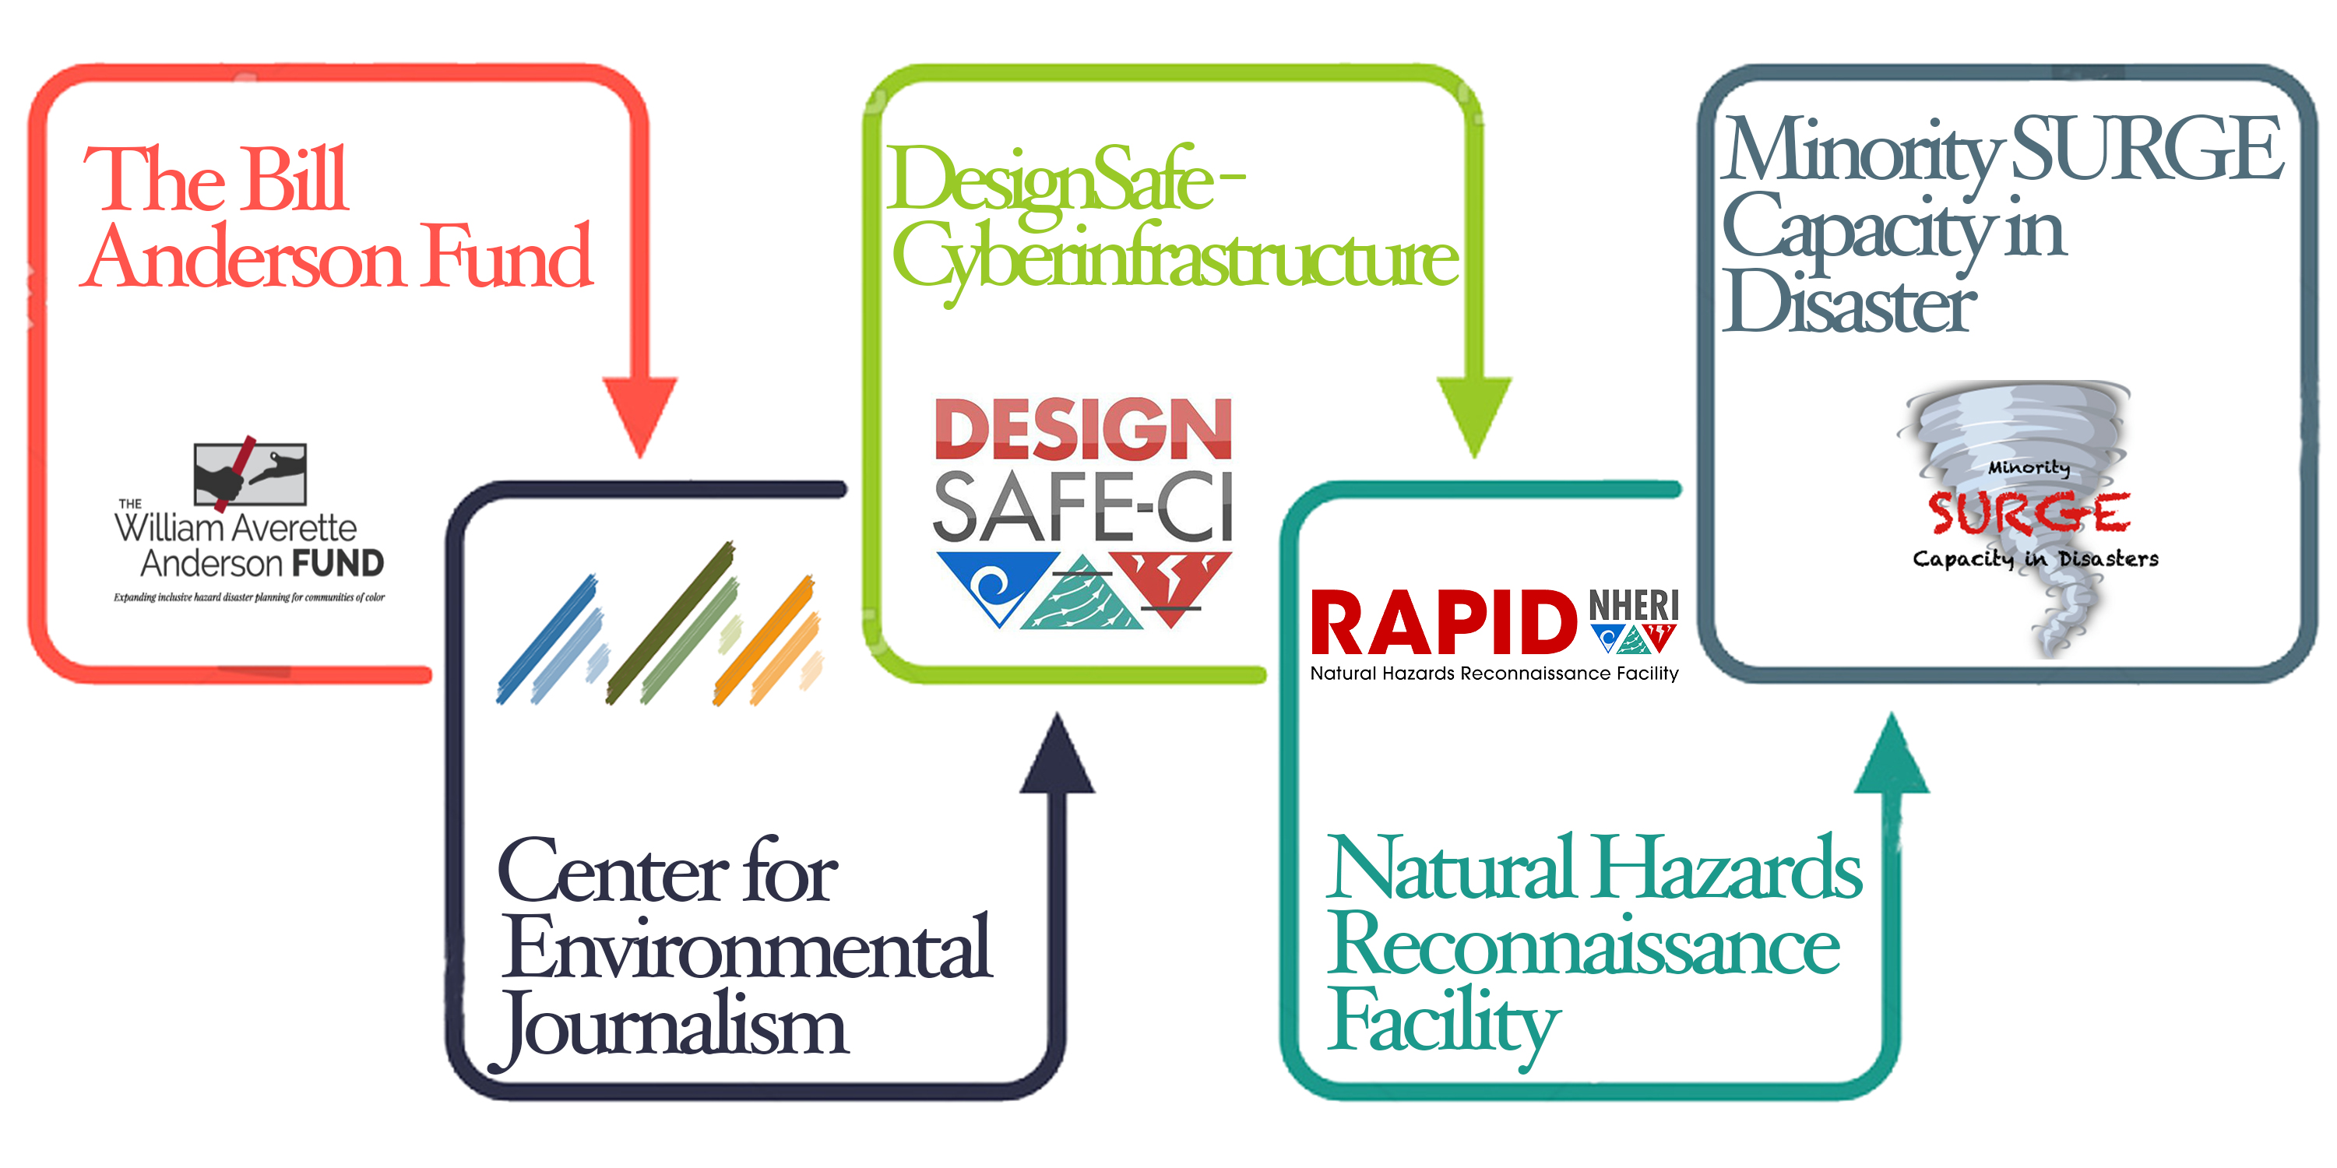

CONVERGE
Coordinated Social Science, Engineering, and Interdisciplinary Extreme Events Research
Thank you for your time and attention and special gratitude to all CONVERGE partners, collaborators, and supporters!
Lori Peek, Ph.D.
Professor, Department of Sociology
Director, Natural Hazards Center
University of Colorado Boulder
Lori.Peek@Colorado.edu
Notes:
Thank you so much for your time and attention today, and much gratitude to all partners and collaborators, as well as a special thanks to Julio, Robin, and Joy.
If you have questions or comments, you can contact Lori at Lori.Peek@Colorado.edu.

