Slide 1

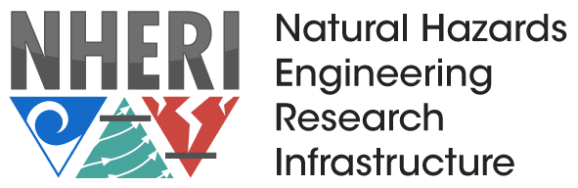
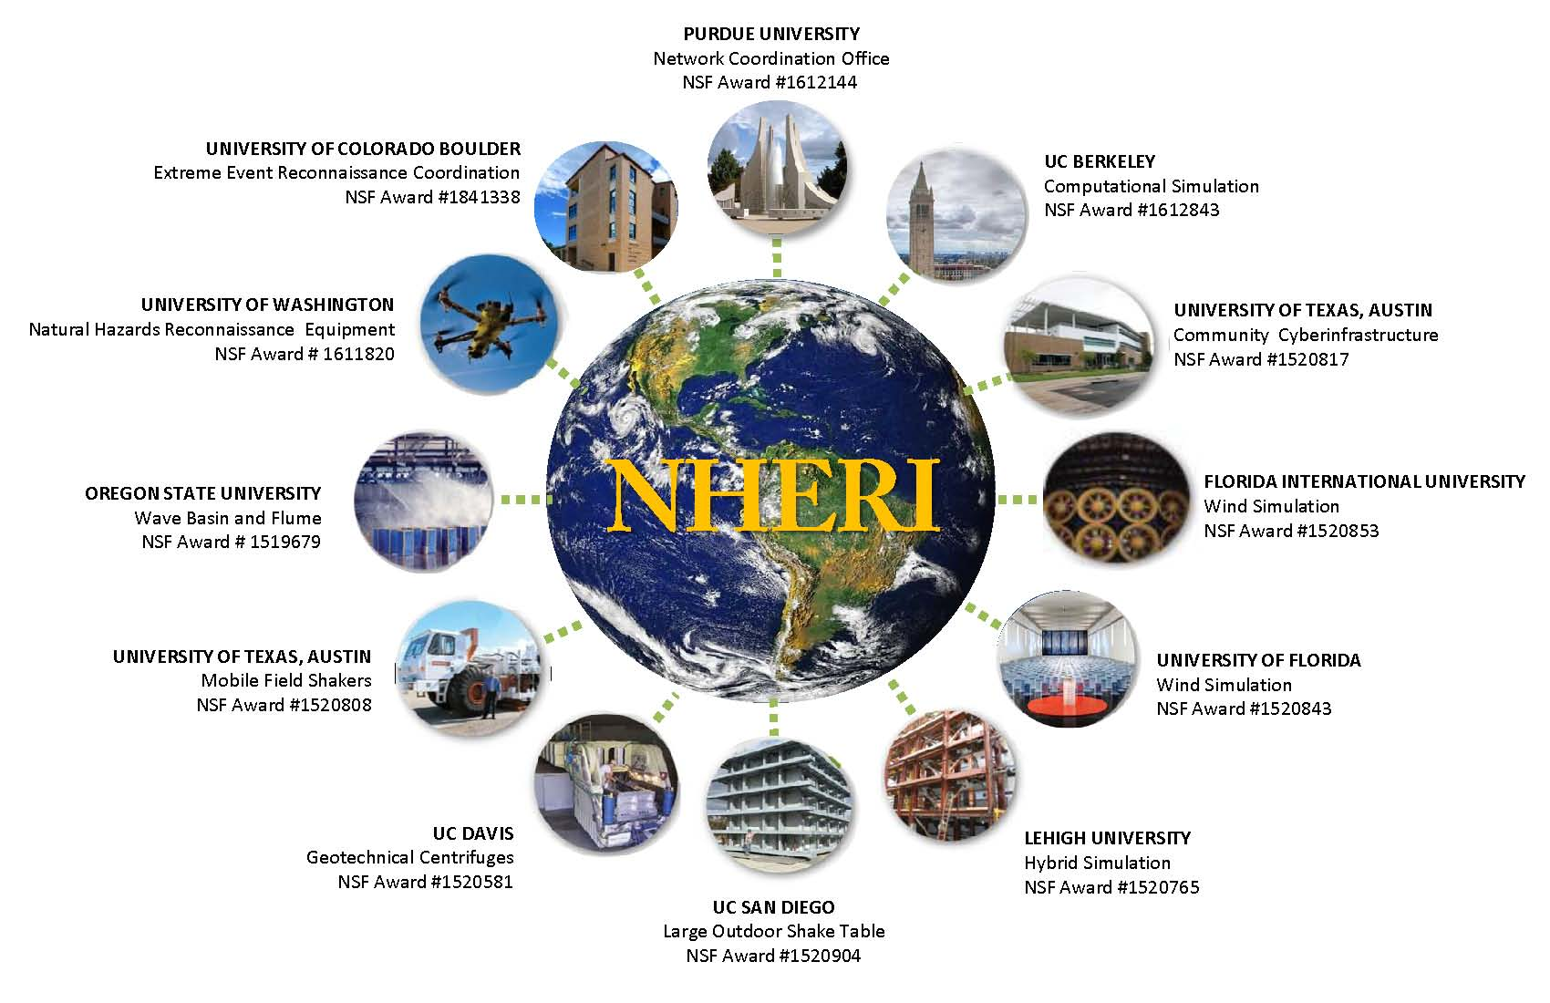
NSF’s Facilities/Programs
Notes:
NATURAL HAZARDS ENGINEERING RESEARCH INFRASTRUCTURE
The Natural Hazards Engineering Research Infrastructure (NHERI) is a distributed, multi-user, national facility that provides the natural hazards engineering community with state-of-the-art research infrastructure. The more than 60M infrastructure funded by the National Science Foundation (NSF), NHERI enables researchers to explore and test ground-breaking concepts to protect homes, businesses and infrastructure lifelines from the impacts of earthquake, wind, and water hazards, enabling innovations to help prevent natural hazards from becoming societal disasters.
NHERI represents a collaboration between 12 NSF awards that support the following:
Network Coordination Office (NCO)
The Network Coordination Office organizes and works with the multi-hazards research community, leads education & outreach activities, coordinates scheduling for all experimental facilities within the community.
DesignSafe is the CI component of the NHERI collaboration. DesignSafe embraces a “cloud” strategy for the “big data” generated in natural hazards engineering research. It supports research workflows, data analysis and visualization.
Experimental Facilities
To help better understand and resist the impacts of earthquake, wind and water hazards, NHERI provides a network of shared, state-of-the-art research facilities and tools located at universities around the country.
Computational Modeling and Simulation Center (SimCenter)
The goal of the SimCenter is to provide the natural hazards engineering research and education community with access to next-generation computational modeling and simulation software tools, user support, and educational materials.
CONVERGE
The CONVERGE facility builds and support the research partnerships and creative thinking needed to address complex problems that are posed by natural hazards, unsustainable development, and rising economic inequality.

