Slide 1
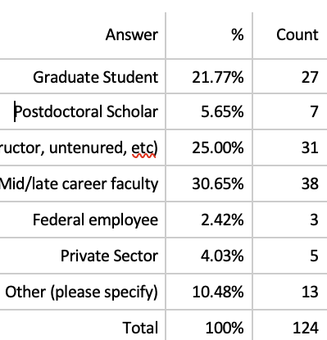

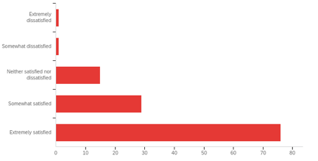
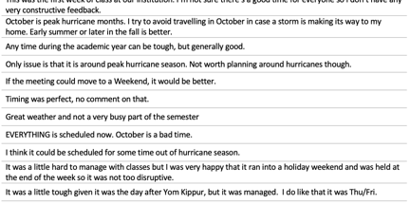
Post Summit Survey and Results
Jennifer Thornhill, Jennifer Bridge, Dan Cox, Julio Ramirez
Survey was 19 questions
Each question had
  Likert scale (1-5)
  Open comment
Sent ~1 week after Summit
Bad
Good
N
~ 30 comments per question
Likert – quick thumbs up/thumbs down
Open ended – good feedback for improvement
Approx. 30 comments per question
44% response rate
77% responders were from universities

Slide 2
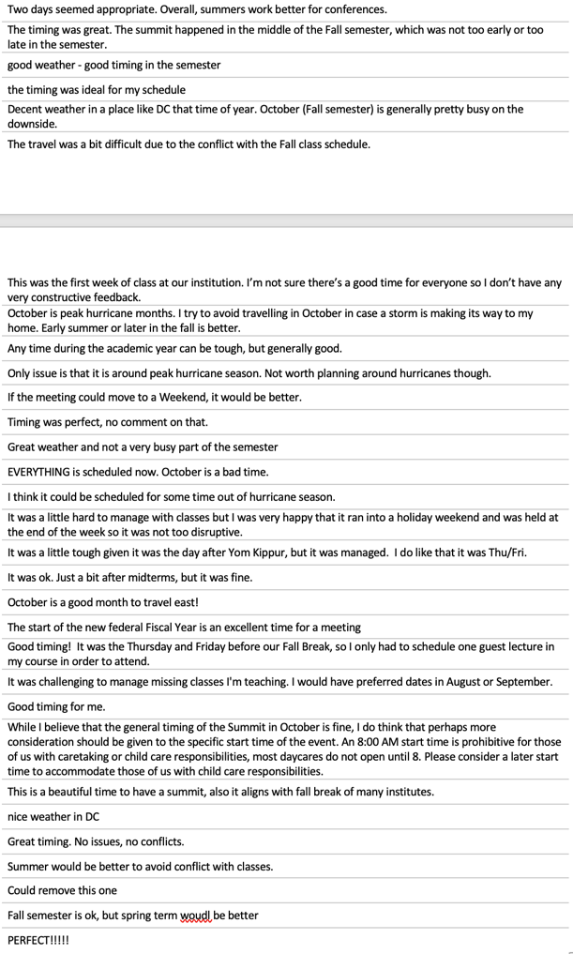

Q10 - What was your overall level of satisfaction with the TIMING of the Summit in October?
The travel was a bit difficult due to the conflict with the Fall class schedule
Bad
Great weather and not a very busy part of the semester
Summer would be better to avoid conflict with classes.
Good
most people were ok with the timing . . .
Fall semester is ok, but spring term would be better
I think it could be scheduled for some time out of hurricane season.
. .. but comments suggest revisiting timing next time (Spring, Summer)
. .. not during hurricane season

Slide 3
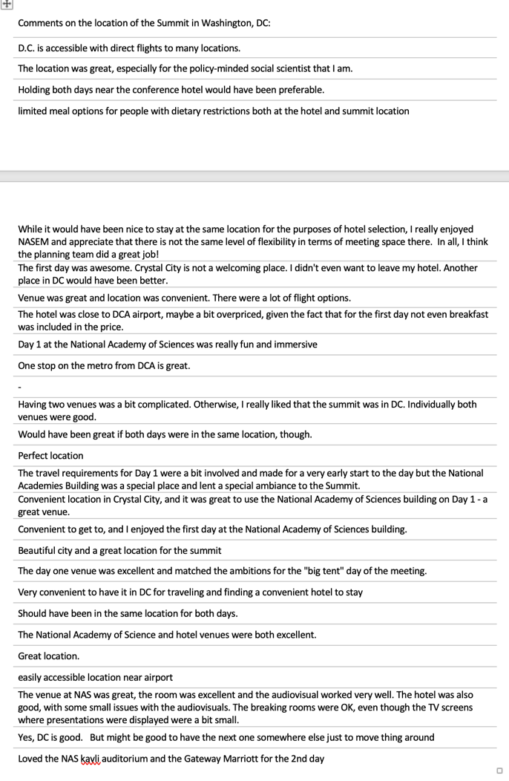
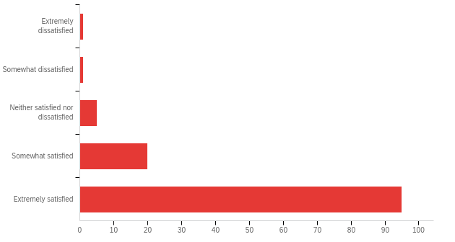
Q12 - What was your overall level of satisfaction with the LOCATION of the Summit in Washington, DC?
D.C. is accessible with direct flights to many locations.
Bad
Convenient to get to, and I enjoyed the first day at the National Academy of Sciences building.
The day one venue was excellent and matched the ambitions for the "big tent" day of the meeting.
Good
Should have been in the same location for both days.
most people liked the location
Yes, DC is good. But might be good to have the next one somewhere else just to move thing around
convenience
NASEM venue was good
not everyone liked 2 locations

Slide 4
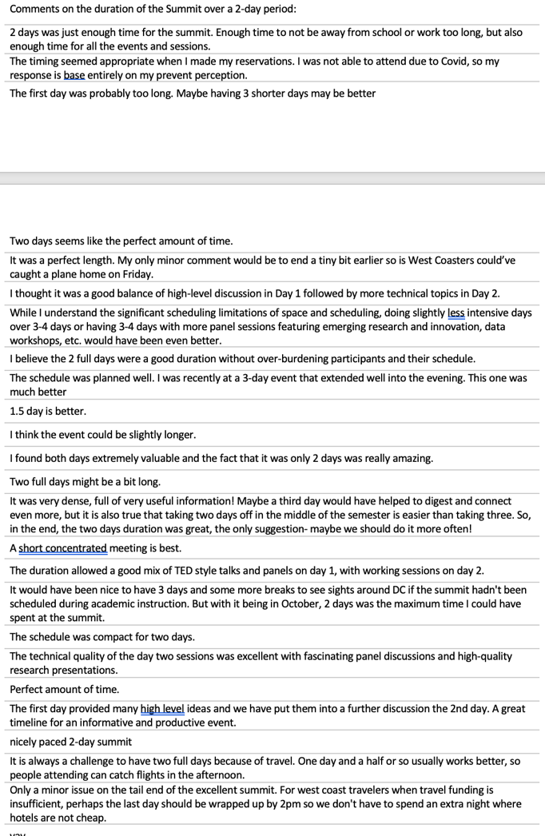
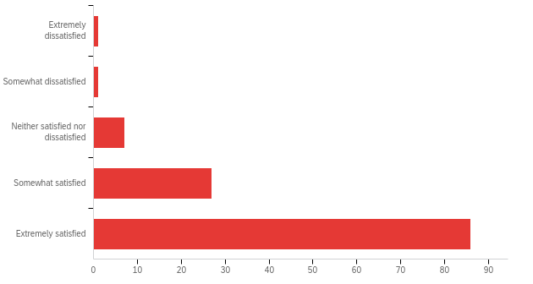
Q14 - What was your overall level of satisfaction with the DURATION of the Summit over a 2-day period?
2 days was just enough time for the summit. Enough time to not be away from school or work too long, but also enough time for all the events and sessions
Bad
It was very dense, full of very useful information! Maybe a third day would have helped to digest and connect even more, but it is also true that taking two days off in the middle of the semester is easier than taking three.
It is always a challenge to have two full days because of travel. One day and a half or so usually works better, so people attending can catch flights in the afternoon.
Good
2-day duration was good, but …
The duration allowed a good mix of TED style talks and panels on day 1, with working sessions on day 2
...make it longer or shorter

Slide 5
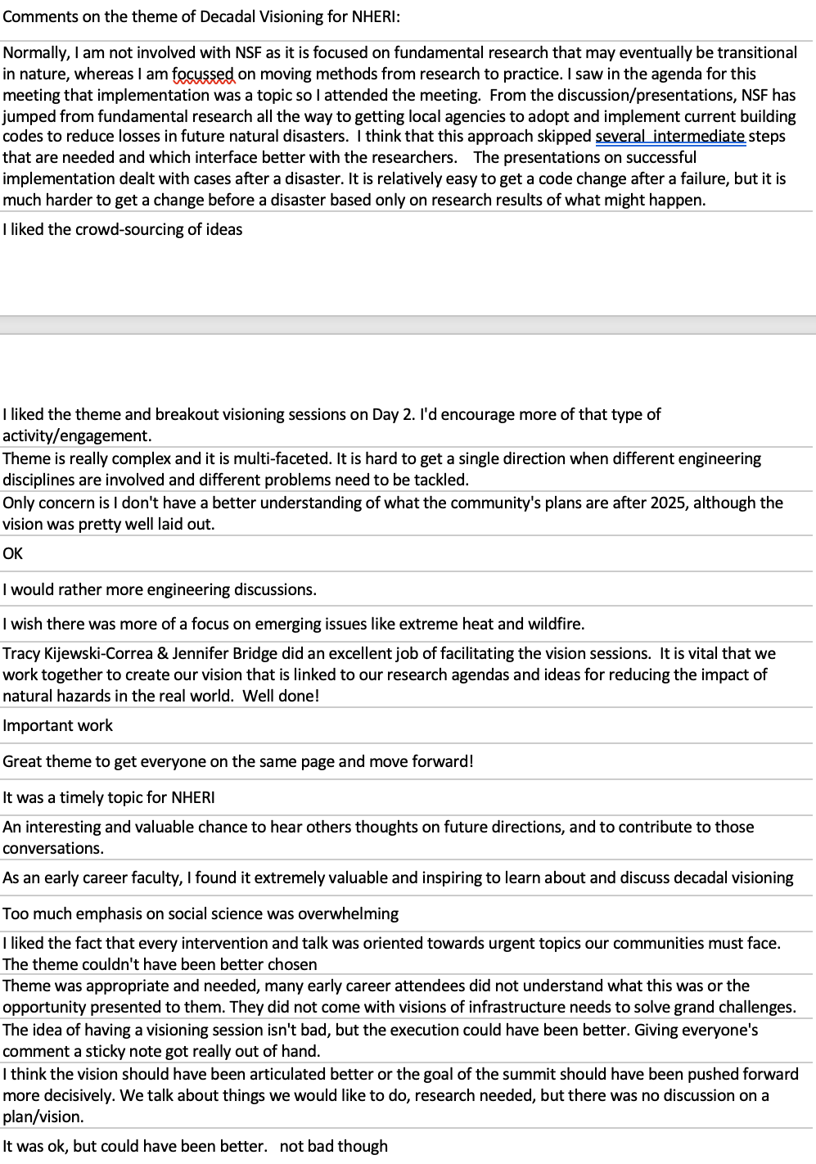
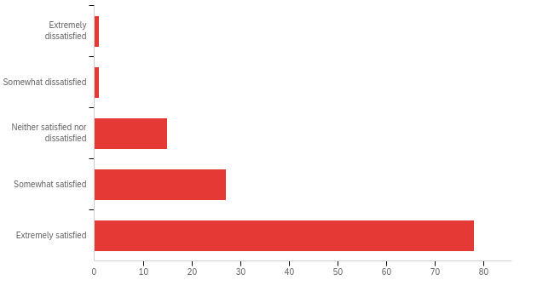
Q16 - What was your overall level of satisfaction with the theme of Decadal Visioning for NHERI
I would rather more engineering discussions.
It is vital that we work together to create our vision that is linked to our research agendas
Bad
As an early career faculty, I found it extremely valuable and inspiring to learn about and discuss decadal visioning .
Good
Only concern is I don't have a better understanding of what the community's plans are after 2025, although the vision was pretty well laid out.
Satisfaction level goes down a little
I liked the crowd-sourcing of ideas .
good suggestions on what to keep, where to improve
Giving everyone's comment a sticky note got really out of hand.

Slide 6
Day 1 specific questions
Day 2 specific questions
Q19 - What was your overall level of satisfaction with the VENUE for Day 1 at the National Academies of Sciences Building?
Q26 - What was your overall level of satisfaction with the VENUE for Day 2 at the Crystal City Marriot Hotel ?
Q21 - What was your overall satisfaction with the ORGANIZATION of the Day 1 activities?
Q28 - What was your overall satisfaction with the ORGANIZATION of the Day 2 activities?
Q23 - What was your overall satisfaction with the CONTENT of the Day 1 activities?
Q30 - What was your overall satisfaction with the CONTENT of the Day 2 activities?
lots of good suggestions on what to keep, where to improve

Slide 7
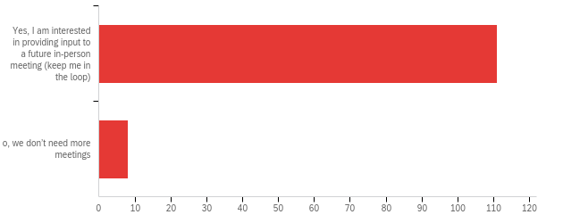
Q34 - Is it worthwhile to discuss a future in-person National NHERI-supported meeting (e.g, > 250 people, 2-day)? The purpose of a NATIONAL meeting is to provide a venue to strengthen the collaborative network of people, ideas and tools.
Yes, I am interested in providing input to a future in-person meeting (keep me in the loop)
No, we don’t need more meetings

Slide 8
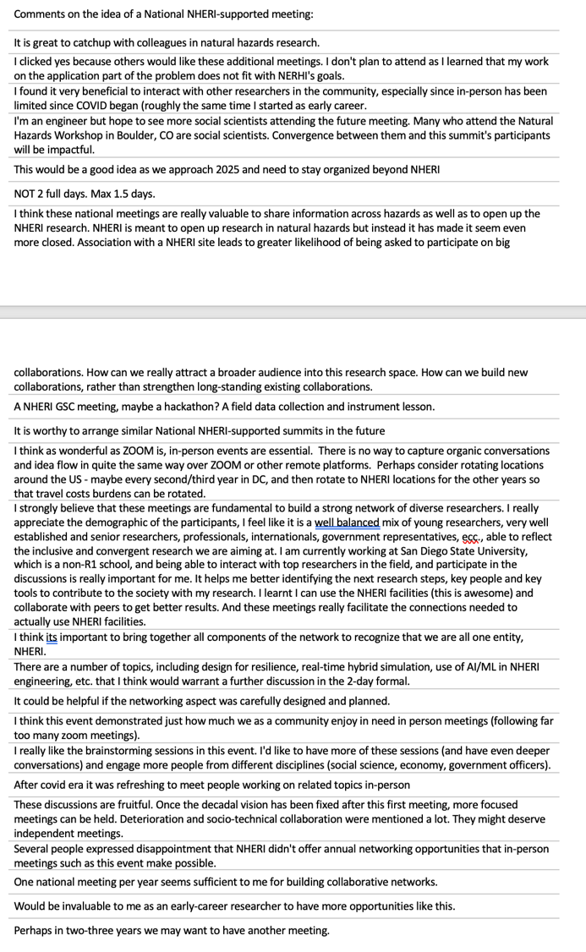
Q34: another NATIONAL meeting?
These discussions are fruitful. Once the decadal vision has been fixed after this first meeting, more focused meetings can be held
These discussions are fruitful. Once the decadal vision has been fixed after this first meeting, more focused meetings can be held
Would be invaluable to me as an early-career researcher to have more opportunities like this.

Slide 9
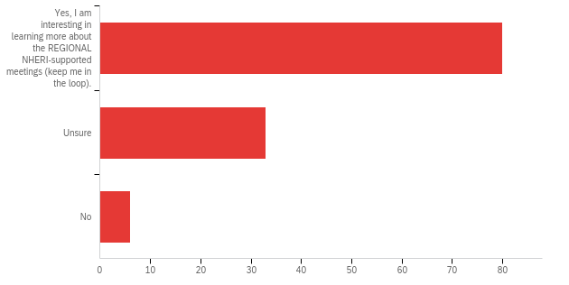
Q35 - Is it worthwhile to discuss future in-person REGIONAL NHERI-supported meetings (e.g., < 75 people, half-day).? The purpose of REGIONAL meetings is to broaden the participation of people into the network particularly early career researchers, students, people at non-R1 institutions, and community ‘super stakeholders’, with an emphasis on regional disasters and opportunities within the NHERI network.
Yes, I am interested in learning more about the REGIONAL NHERI-supported meetings (keep me in the loop)
Unsure
No

Slide 10
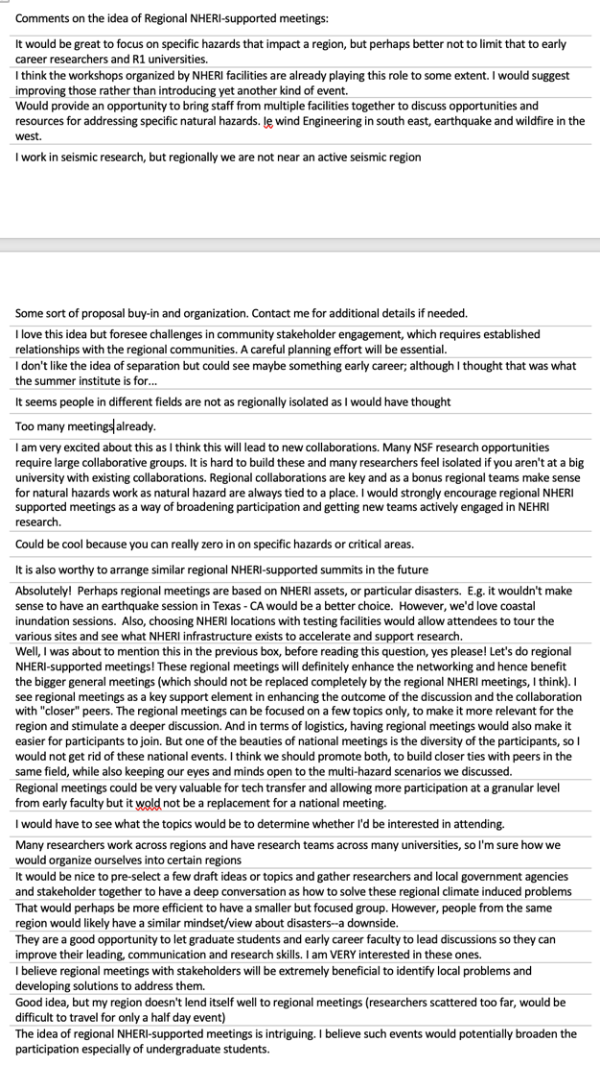
I am very excited about this as I think this will lead to new collaborations.
Q35: REGIONAL meetings?
Absolutely! Perhaps regional meetings are based on NHERI assets, or particular disasters.
Let's do regional NHERI-supported meetings! These regional meetings will definitely enhance the networking . . .
I believe regional meetings with stakeholders will be extremely beneficial to identify local problems and developing solutions to address them
an idea worth exploring

Slide 11
Post Summit survey result – main takeaways
Positive response on timing, venues, organization/duration, theme
Valuable written feedback on what worked, where to improve
Favorable response to having another NATIONAL meeting
Mixed response to REGIONAL meetings, but idea is worth exploring

