Slide 1
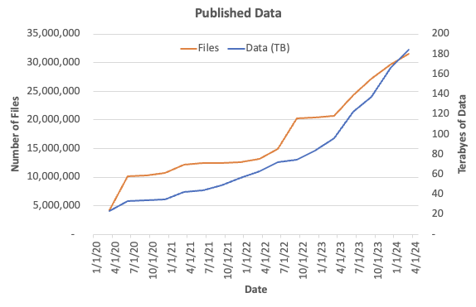
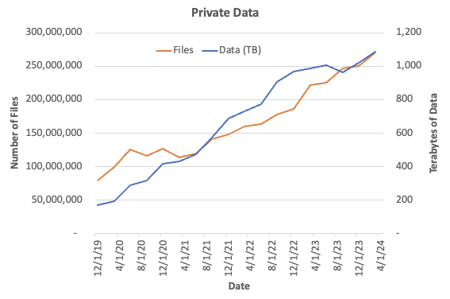
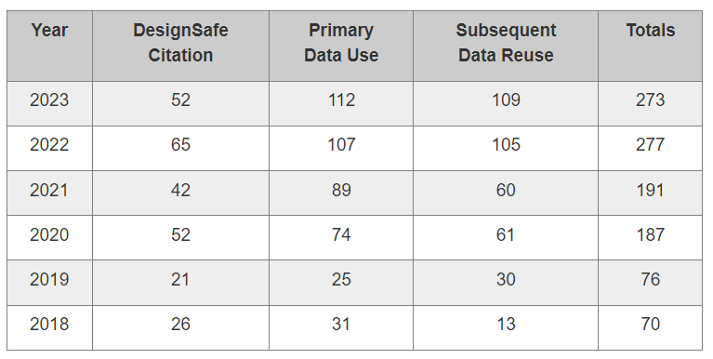
Transforming Hazards Research
Data Reuse
142
140
346
~400,000 published files accessed
~1,000 published datasets

