Slide 1

Natural Hazards Engineering Research
Infrastructure (NHERI)
2017 REU – Research Opportunities for Undergraduates
Literature Review
Summer 2017

Slide 2

Overview
Provide research project overview
Discuss literature review
Review upcoming deadlines & events

Slide 3
Research Project Overview
Name
Mentor
Research Project Description
  Research project title
  Research question
  Goals & activities
  Methods used

Slide 4
Literature Review
Read your publication and highlight quoted/cited literature.
  Look for last names, parenthesis (), other forms of citations
What is the purpose of each citation? (Write this on the side of the margin.)

Slide 5
Purpose of the Literature
Purpose – Does the literature/citation report on:
  Background of the study/historical event/natural hazard?
  Context of the study?
  Need for the study?
  Methodologies?
  Results?

Slide 6
Document Sharing
Take turns sharing documents over Zoom
  Pay close attention to the citations used in the articles.
  What citation format is being used?

Slide 7
Annotated Bibliography
Citation (in the appropriate format)
Summary (include purpose, study, method(s), results)
Purpose (how you might use the article’s contents in your research paper)
Vielma, K. I. (2016). STEMujeres: A case study of the life stories of first-generation Latina engineers and scientists. Dissertation.
The purpose of this qualitative case study of the life histories of three Latina engineers was to present successful trajectories of women who completed bachelors, masters, and doctoral degrees. Results point to quality connections with faculty, peers who were one step ahead educationally, and academic preparation for the next career stage.
I might use this article for my study’s methodology since it presents interesting ways to interview participants.

Slide 8
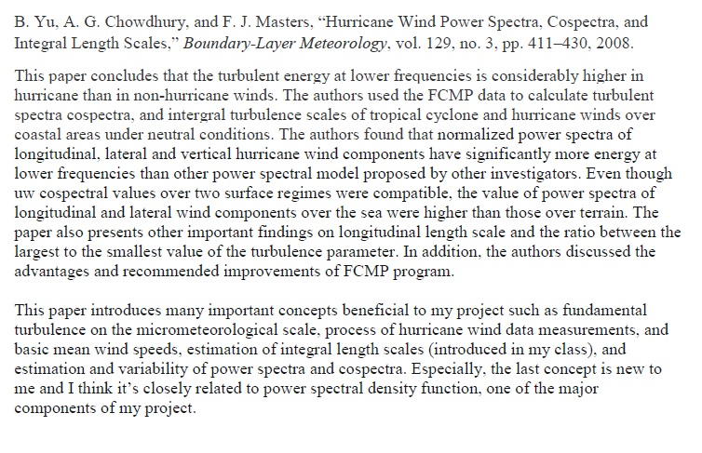
Annotated Bibliography - Example
D. Nguyen (REU, 2017)

Slide 9
Deliverables
Send the following to karina.vielma@utsa.edu by Tuesday, June 27 at 11am (Central):
    Sample peer-reviewed paper: Send pdf file.
    Annotated bibliography for literature review: Citation, summary of the article, how you might use the article’s contents in your research paper.
    Research Plans: Signed form with your summer research goals.
    Timesheet: Record all research activities from Monday (June 19)-Friday (June 23). Must be signed by your faculty mentor.
    Photo Release: Print, sign, scan, and send.

Slide 10
Questions?
Please feel free to contact me if you have any questions or concerns. We are here to help all REU students have the best summer research experience possible.
  Karina I. Vielma, Ed.D.
  NHERI Research Fellow and Education Specialist
  (210) 458-5596
  Karina.Vielma@utsa.edu
  Cell phone number: (830) 752-5455
Slide 22

