Slide 1

Natural Hazards Engineering Research
Infrastructure (NHERI)
2017 REU – Research Opportunities for Undergraduates
Educational Lesson Plan
for Engineering
Summer 2017

Slide 2

Today’s Schedule
Icebreaker & Introductions
Objectives
Activity
Engineering Design Process
Educational Lesson Planning
TeachEngineering.org
Deliverables
Closure

Slide 3
Icebreaker
Introduce yourself in alphabetical order. (A-Z) Complete the following sentence:
If I could be a ______, I would be a ______ _______.
A B A

Slide 4
Introductions
Introduce yourself:
Name
Experimental site
How did you know you wanted to be an engineer/scientist/_______?

Slide 5
Objectives
Learn about the Engineering Design Process
Explain how to create a lesson to engage K-12 students
Understand how a lesson connects to research

Slide 6
Activity
Think of a research, scientific, coding, or engineering problem you recently solved.
What steps did you take to solve the problem?
(If you are at the same site, work together with your partner. Create a PowerPoint slide with your group/partner of these steps. Prepare to share.)

Slide 7
Activity
Ask: Identify the need and constraints
Manually count sensors (UCSD)
Excel sheet (UCSD)
Knows and unknown (UCB)
Gather resources (UCB)
Model paper from PI (UTA/OSU)
Research the problem
Consult with grad student (UCSD)
Analyze the problem (Lehigh)
Brainstorm ideas (UCD)
Understand the problem (UCB)
Imagine: Develop possible solutions
Graph/use GUI for layout (UF)
Pretotyping drawing (FIU)
How to fix/recalculate (Lehigh)
Plan: Select a promising solution
Purchase weather station (FIU)
How to fix? (Lehigh)
Create: Build a prototype
Write the code (UF)
Design WDR gauge (FIU)
Creating the initial code (UCD)
Compile annotated bib (UTA/OSU)
Test and evaluate prototype
Trial and error (UF)
Compare data from different sources (FIU)
Check corrections (Lehigh)
Test code for errors (UCD)
Attempt problem (UCB)
Evaluate results (UCB)
Evaluate sources (UTA/OSU)
Improve: Redesign as needed
Redesign code (UF)
Use as a building block (Lehigh)
“Perfect” the code
Reattempt (UCB)

Slide 8
Engineering and Technology
Engineering: The creative application of scientific (including math) principles to design, develop, and/or predict behavior of structures, machines, apparatus, or processes for an intended function (societal problem), with consideration of economics, ethics, and safety to life and property (ABET)
Technology: The product created by engineers/engineering process.

Slide 9
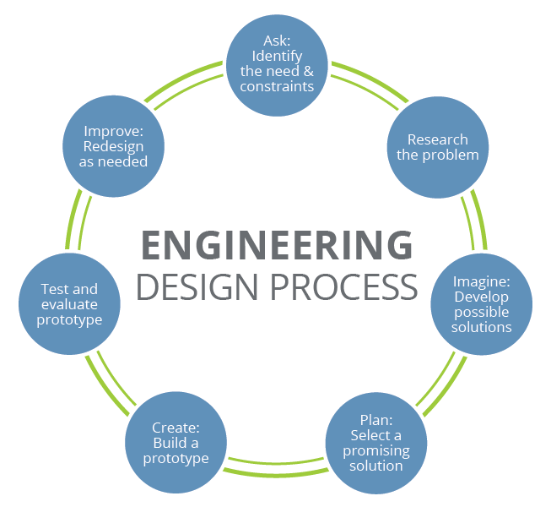
Engineering Design Process

Slide 10
Lesson Planning
Identify a topic and learning objectives
What do you want students to learn?
Develop an introduction
Plan learning activities
Develop a plan to assess understanding
How will you know that students learned the objectives?
Conclusion

Slide 11
Lesson Planning
Decide what engineering or scientific concept related to your research you will address
Decide the age-group to engage in your activity
Decide if you will create a unit, lesson, activity, sprinkles, or challenge maker
Use the appropriate lesson plan template to complete the lesson
Go to TeachEngineering.org → Get involved → Submit curriculum → Activity Template (Blank)

Slide 12
Deliverables
Bring a lesson draft on Monday, July 10th. We will review all lessons.
Final lessons due to Karina by July 19, 2017 at 12noon Central Time.
You will meet with K-12 teachers on July 26 from 11-1pm. Please plan to Zoom in.
Your lesson posters will be presented at the same time as our final research posters at our August meeting. (More details to come soon.)

Slide 13
Conclusion
What are the components of the Engineering Design Process?
Each Group/EF site:
How will the lesson tie in to the research concepts of your research project(s)?
How will you engage K-12 students in the lesson?

Slide 14
Questions?
Please feel free to contact me if you have any questions or concerns. We are here to help all REU students have the best summer research experience possible.
Karina I. Vielma, Ed.D.
NHERI Research Fellow and Education Specialist
(210) 458-5596
Karina.Vielma@utsa.edu
Cell phone number: (830) 752-5455
Slide 22

