Slide 1

Natural Hazards Engineering Research
Infrastructure (NHERI)
2017 REU – Research Opportunities for Undergraduates
Educational Lesson Plan
for Engineering
Summer 2017

Slide 2

Today’s Schedule
Today’s Objectives
Review
Engineering and Technology
Engineering Design Process
Re-Introductions & Lesson Updates
Materials Needed
Activity – Review Lesson Plan
TeachEngineering.org Rubric
Deliverables – Where are we going?
Closure

Slide 3
Today’s Objectives
Refine a lesson plan to engage K-12 students
Peer-review lesson plans
Understand how a lesson connects to research

Slide 4
Review: Engineering and Technology
Engineering: The creative application of scientific (including math) principles to design, develop, and/or predict behavior of structures, machines, apparatus, or processes for an intended function (societal problem), with consideration of economics, ethics, and safety to life and property (ABET)
Technology: The product created by engineers/engineering process.

Slide 5
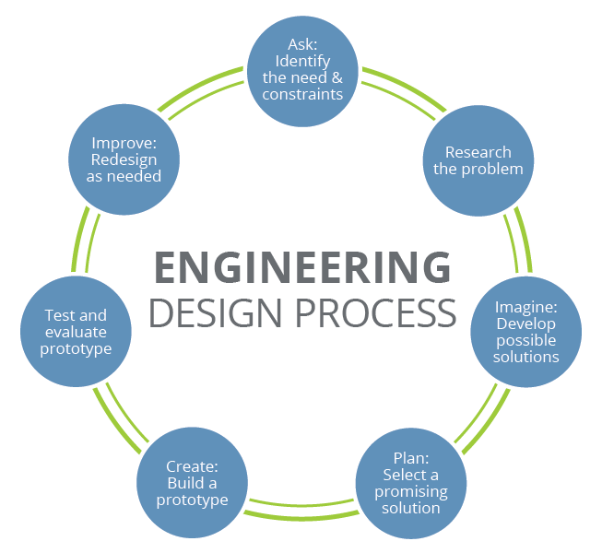
Review: Engineering Design Process

Slide 6
Review: Engineering Design Process

Slide 7
Re-introductions
As a group, introduce yourselves:
Name, EF Site
Tell us:
How your lesson will tie in to the research concepts of your research project(s),
Did you create a lesson, activity, and/or maker challenge, and
What activity will you use to engage K-12 students

Slide 8
Materials Needed
Electronic copy of your lesson plan draft
Your partner(s) if applicable

Slide 9
Activity
Pair up with a partner EF site
Review their lesson plan using the TeachEngineering rubric
In a Word document, record any recommendations you have for the author(s) of the lesson plan
Report the recommendations

Slide 10
Deliverables & Events
We will be traveling to Miami, Florida to tour the Florida International University’s (FIU) Wall of Wind.
FAX
Submit a copy of your license and/or passport via fax to Dr. Karina Vielma (210) 458-5515 as soon as possible.
Students will be traveling together to the site.
Please specify any travel restrictions and dietary restrictions you may have.
Send recommendations to your partner EF site by Wednesday, July 12.
Submit your final lesson plan by July 19 at 12 noon Central time (Next Wednesday).
Clear your calendars for July 26 from 11am-2pm (Central time) to discuss the lesson with a K-12 teacher.
Attend your research meetings – Tuesday, Block 2 & Wednesday, Block 1

Slide 11
Questions?
Please feel free to contact me if you have any questions or concerns. We are here to help all REU students have the best summer research experience possible.
Karina I. Vielma, Ed.D.
NHERI Research Fellow and Education Specialist
(210) 458-5596
Karina.Vielma@utsa.edu
Cell phone number: (830) 752-5455
Slide 22

