Slide 1
Jupyter Notebook workflow
(Agavepy and Pylauncher)
By
Harika Gurram

Slide 2
Outline
Pylauncher is integrated to registered application on Designsafe workspace.
Agavepy makes an API call to the register application and submits the jobs to Stampede2.
Output location is specified for post-processing solutions.
Pros:
Users can use already available applications on the Designsafe workspace. Currently Pylauncher is integrated with ADCIRC and LS-Dyna.
Designsafe – Community allocations can be used directly for simulations.
SLURM takes care of the submission and queue.
Easy to customize pre-process and post-processing solutions.
Cons:
I/O workloads – limiting the number of nodes will limit I/O which also decreases the speed of throughput.
Cannot use for MATLAB – it will open multiple instance which will be difficult to manage.

Slide 3
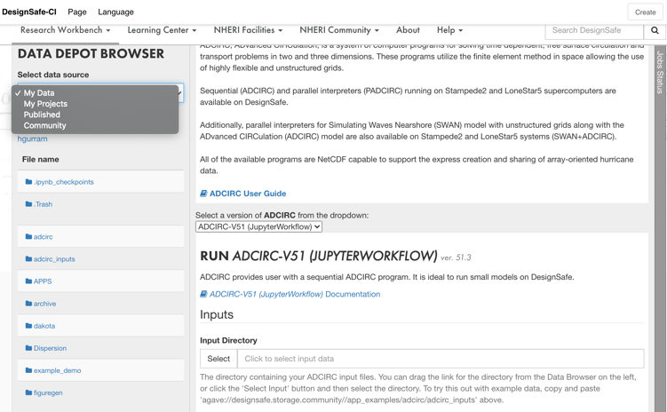
Example 1: ADCIRC workflow on Designsafe workspace
Job submission through app form
Job Status
Inputs location
Choose the application
Working Directory

Slide 4
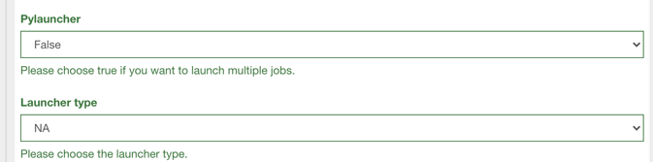
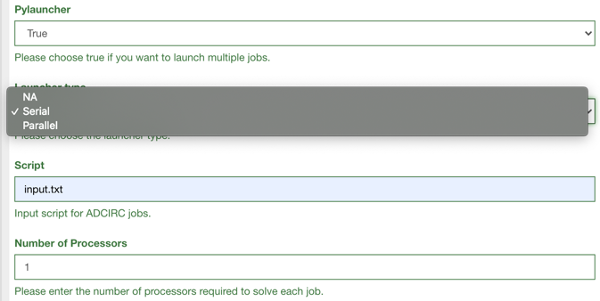
If the user selects false for Pylauncher then the application works for a single input file.
If the user selects true for Pylauncher
Choose the launcher type
Classiclauncher for serial jobs
Ibrunlauncher for parallel jobs
If pylauncher is false
User can select NA for launcher type.
Input directories
Processors per job

Slide 5
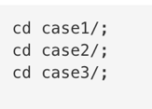
Input directory should be:
Input file should be in the following format

Slide 6
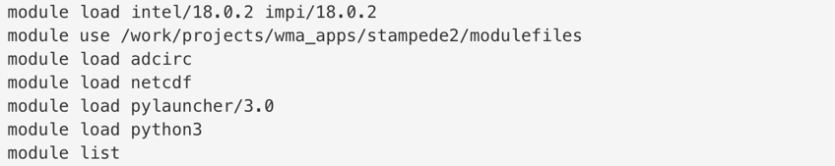
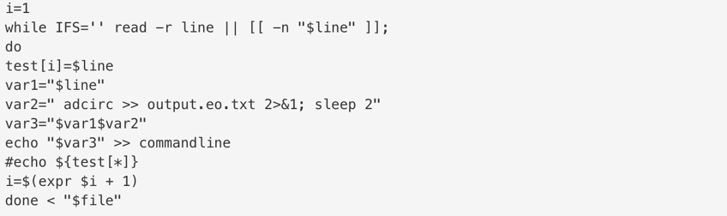
Wrapper script
Loading modules
Setting the work directory
Loading the script file
Creating command lines for Pylauncher

Slide 7
Wrapper script (cont..)
Launcher input for the app form
Loading command lines
Launching serial batch jobs
Launching parallel batch jobs
Launching a single job

Slide 8
Pylauncher
commandlines script:
cd case1/; adcirc >> output.eo.txt 2>&1
cd case2/; adcirc >> output.eo.txt 2>&1
cd case3/; adcirc >> output.eo.txt 2>&1
ClassicLauncher:
import pylauncher3 pylauncher3.ClassicLauncher("commandline",debug="job+task+host+exec+command",cores=8)
IbrunLauncher:
import pylauncher3 pylauncher3.IbrunLauncher("commandline", cores=8, debug="job",)

Slide 9
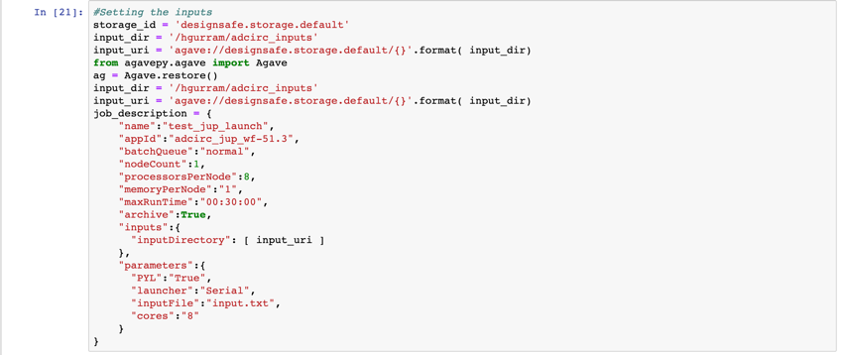
Job Submission through Jupyter Notebook
User can customize the inputs and create a script for job submission
Working directory
Using Agavepy for job submission
Inputs and Job Details

Slide 10
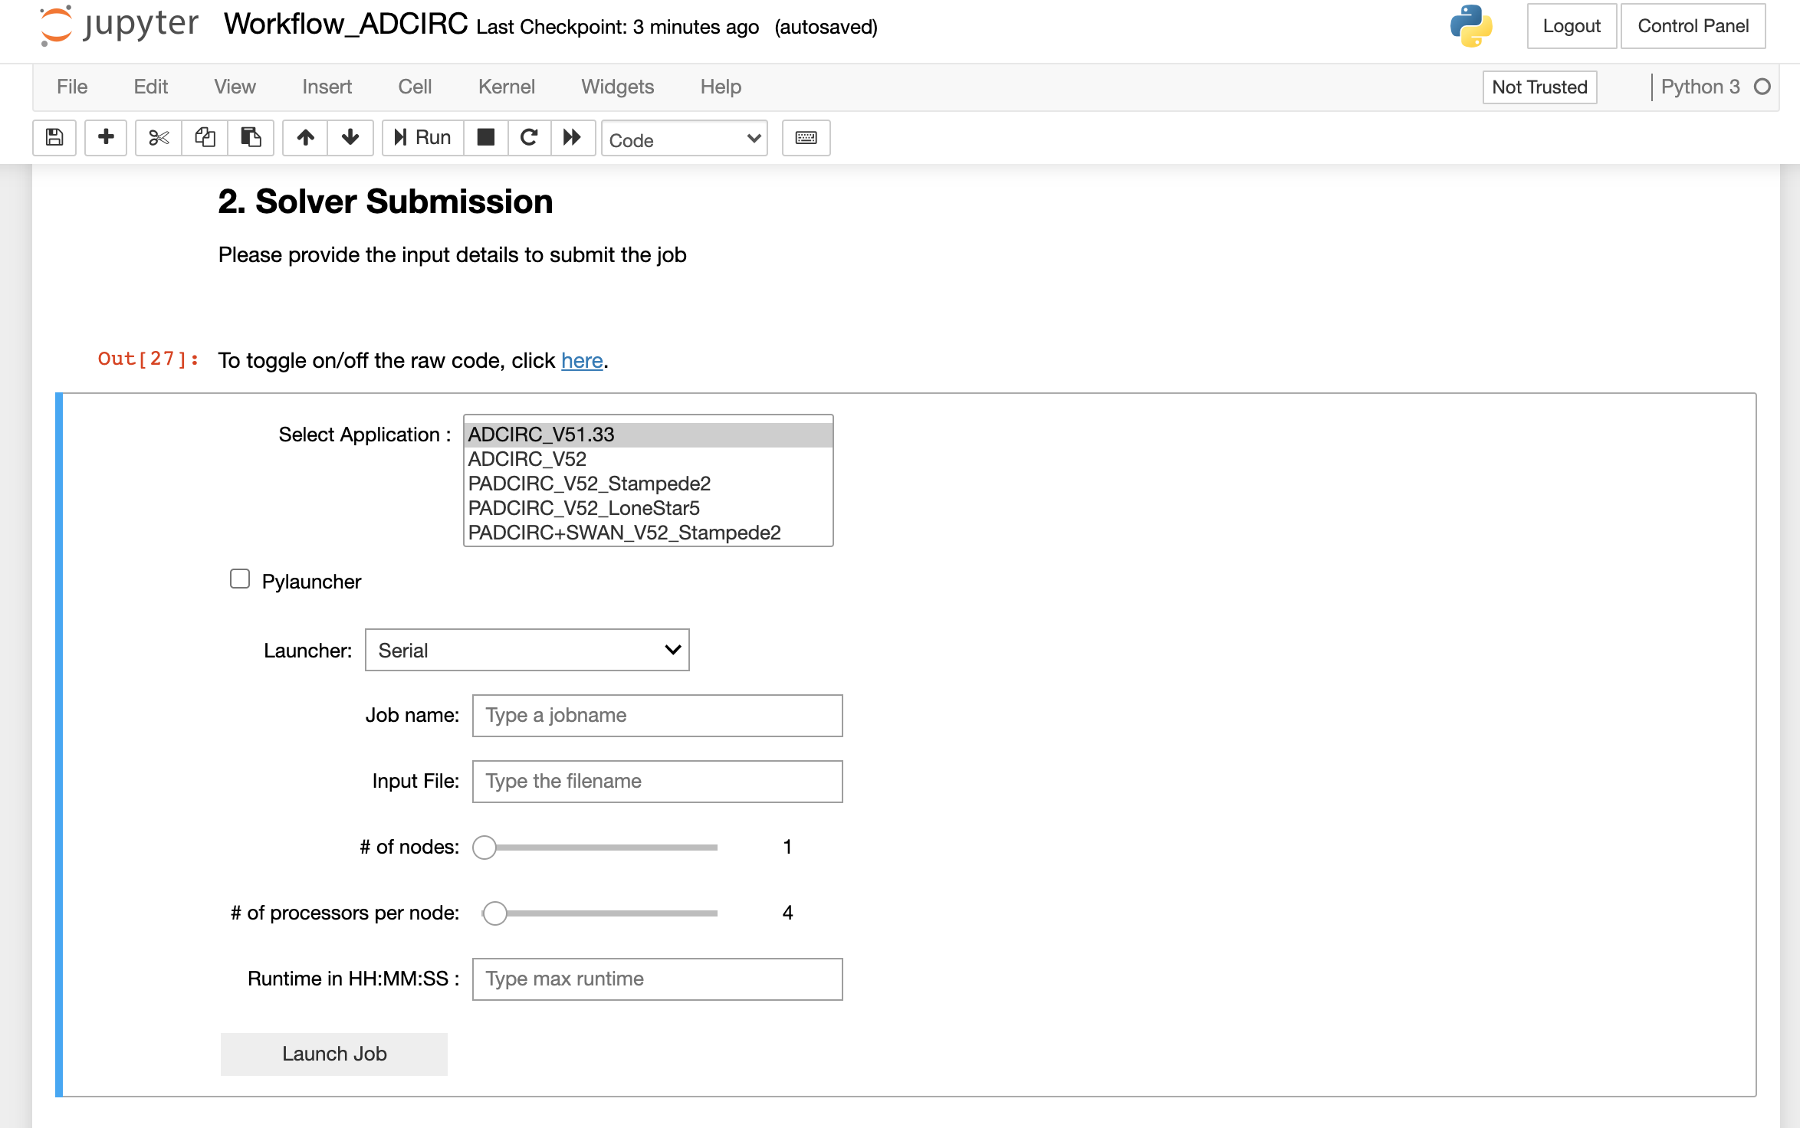
Job Submission through Jupyter Notebook using ipywidgets.
Applications list
Launcher option
Launcher type
Job details
Resources
Job run time
Submit

Slide 11
Output files

Slide 12
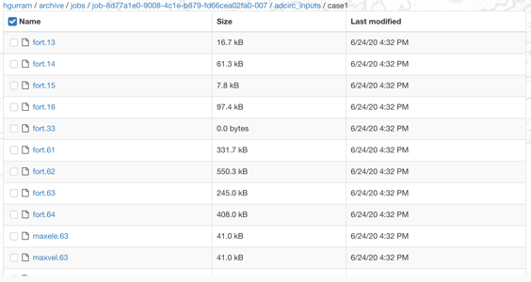
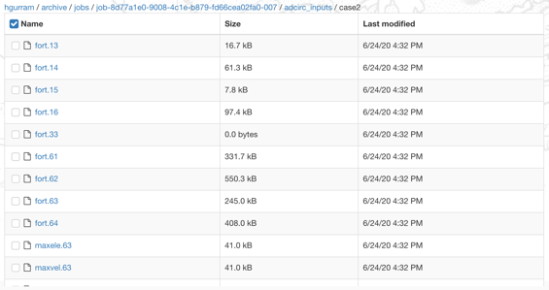
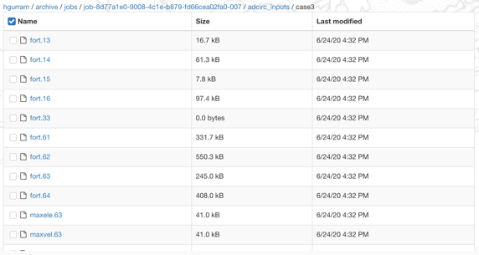
Outputs for Case1, Case2 and Case3

Slide 13
Pylauncher queuestate file
queued
running
completed
0: cd case1/; adcirc >> output.eo.txt 2>&1; sleep 2
1: cd case2/; adcirc >> output.eo.txt 2>&1; sleep 2
2: cd case3/; adcirc >> output.eo.txt 2>&1; sleep 2
Once jobs are submitted within the Jupyter Notebook using Agavepy, the user can check the status on the job status bar located on Designsafe workspace
Please contact me if you have any questions or concerns – hgurram@tacc.utexas.edu

